Slide 1
FiiO Q2-2018….Q1-2019
Examples of Marketing Activities

Slide 2
Press Information
#1
FiiO FH5 – FiiO Attacking Earphone Market
#2
FiiO K3 - Next Generation of FiiO E10K
#3
FiiO M9 - Top FiiO M-Series DAP model
#4
FiiO BR3K – Hi-Res Audio in Bluetooth Module
#5
FiiO FA7 – Quad Driver Earphone Model from FiiO

Slide 3
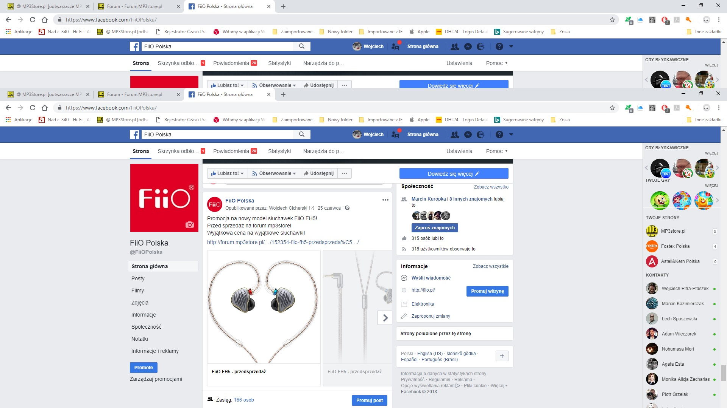
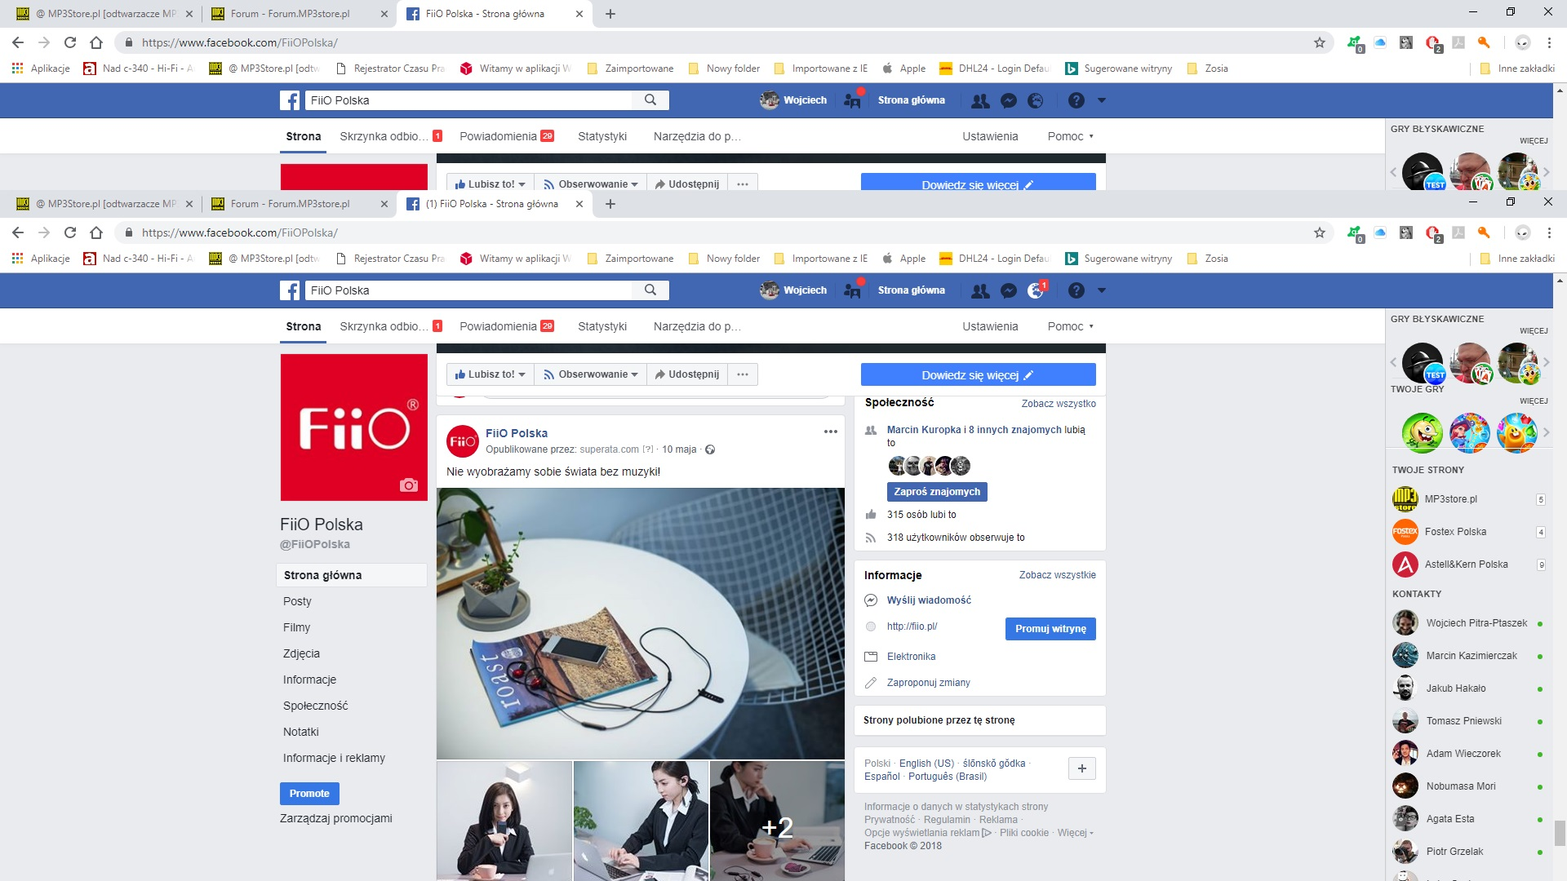
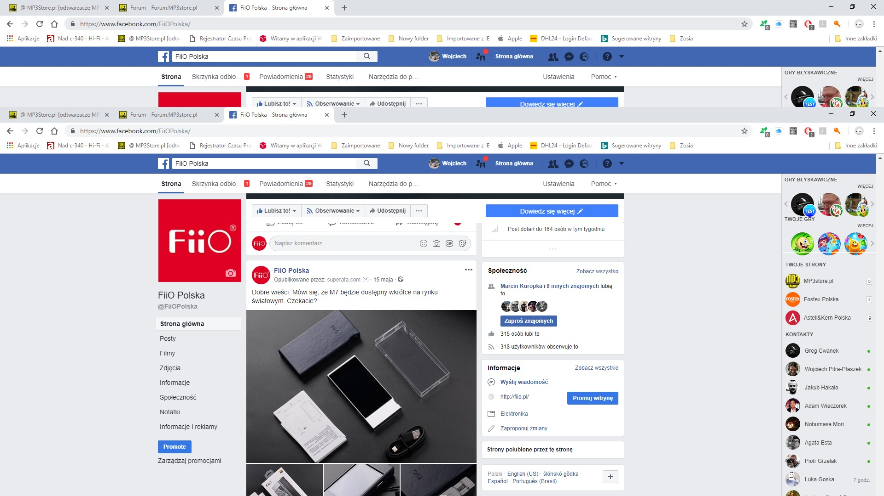
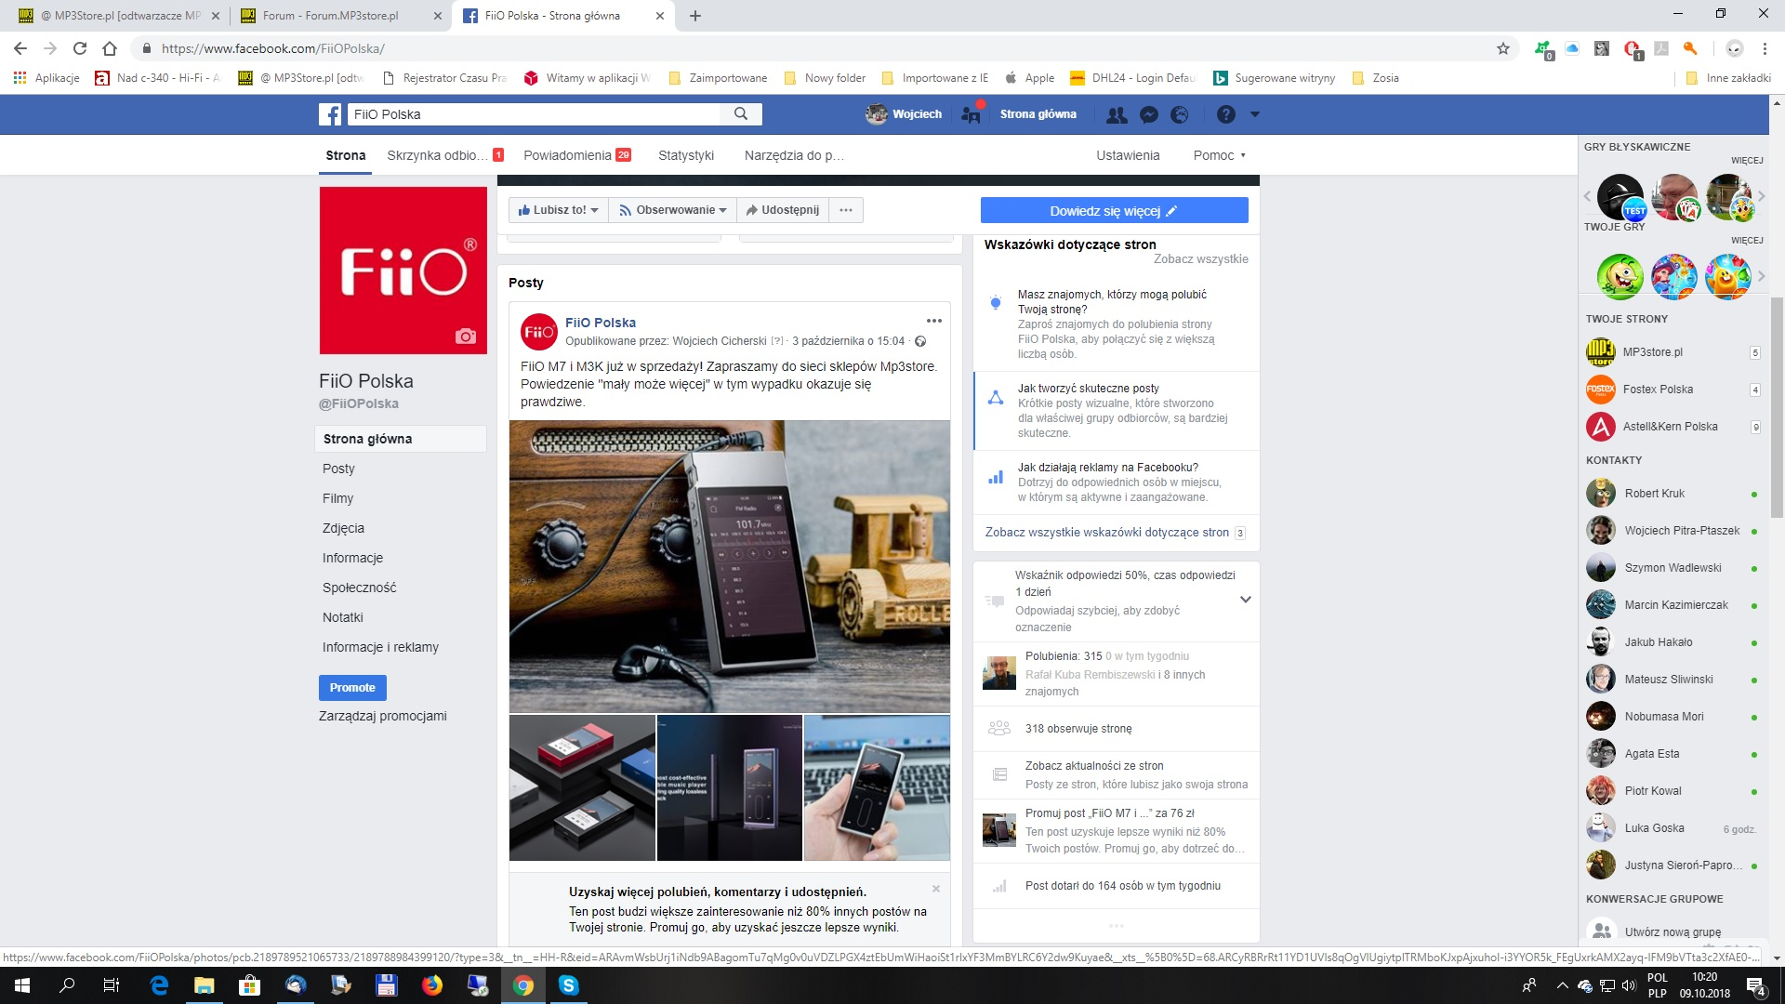
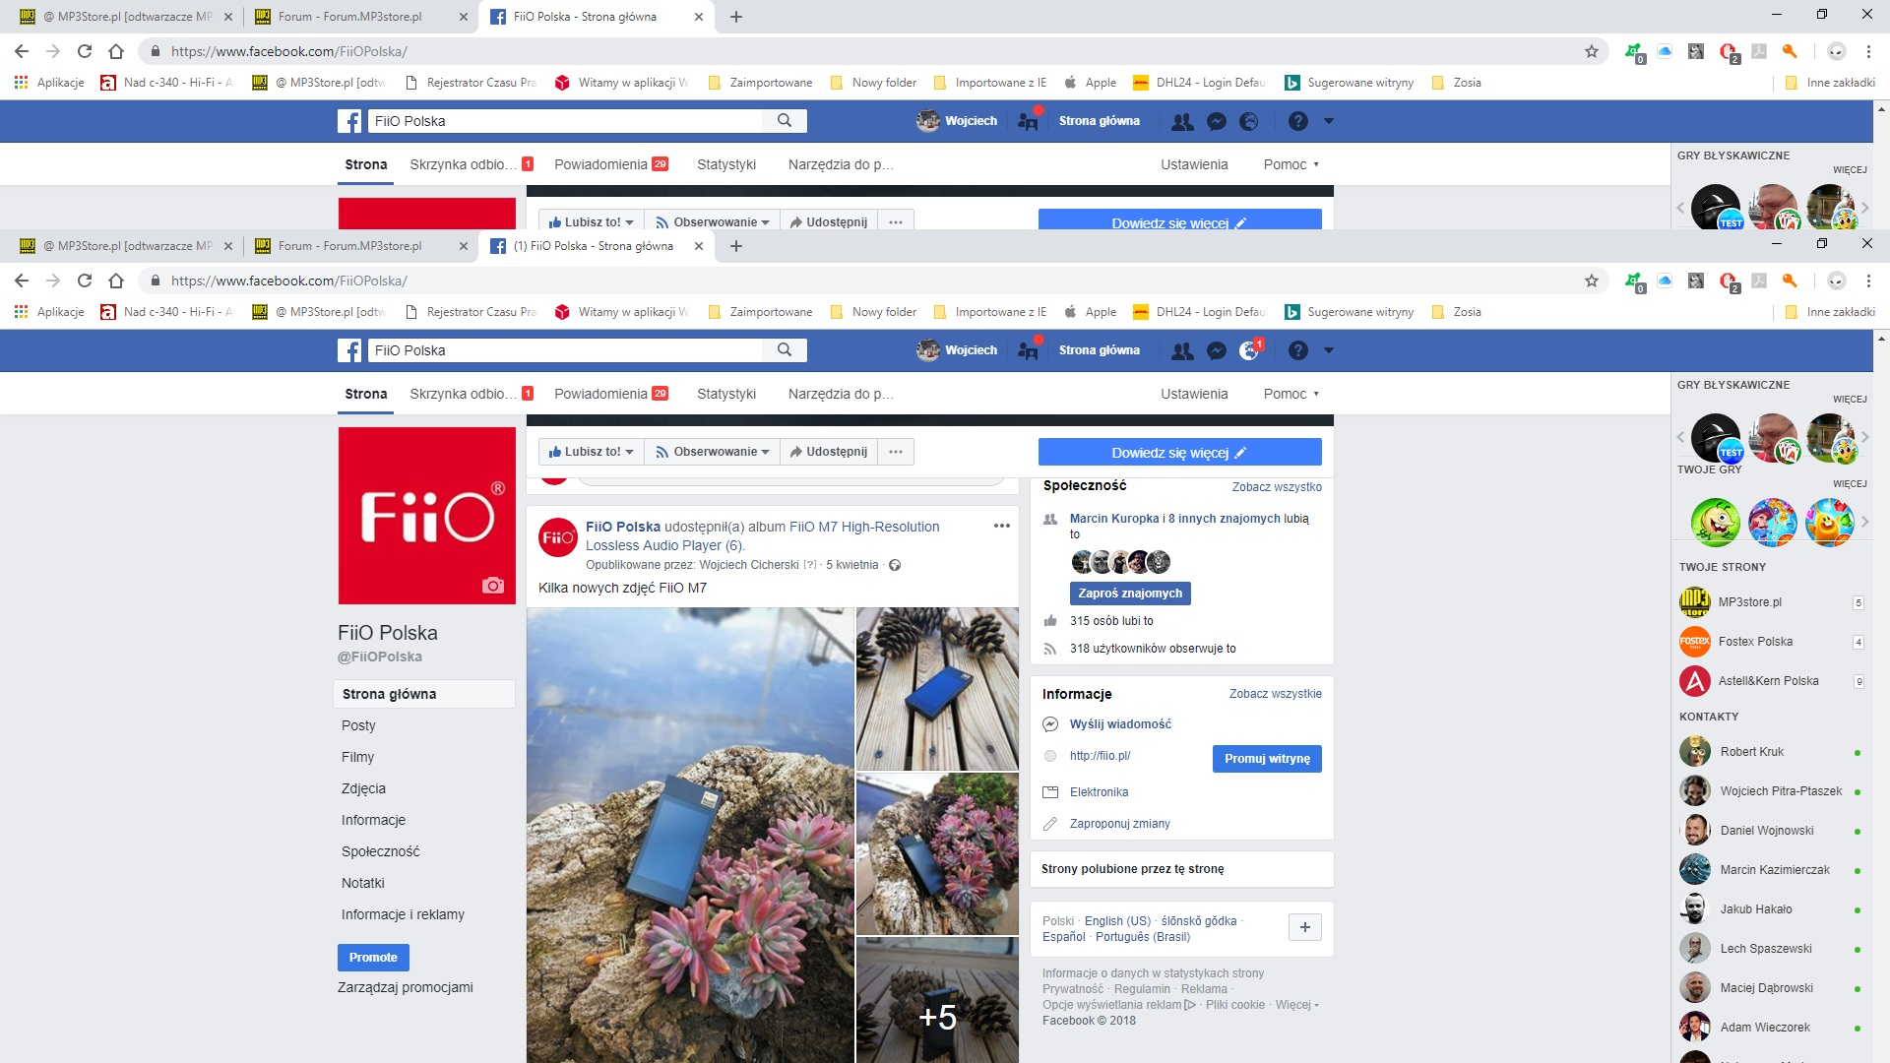
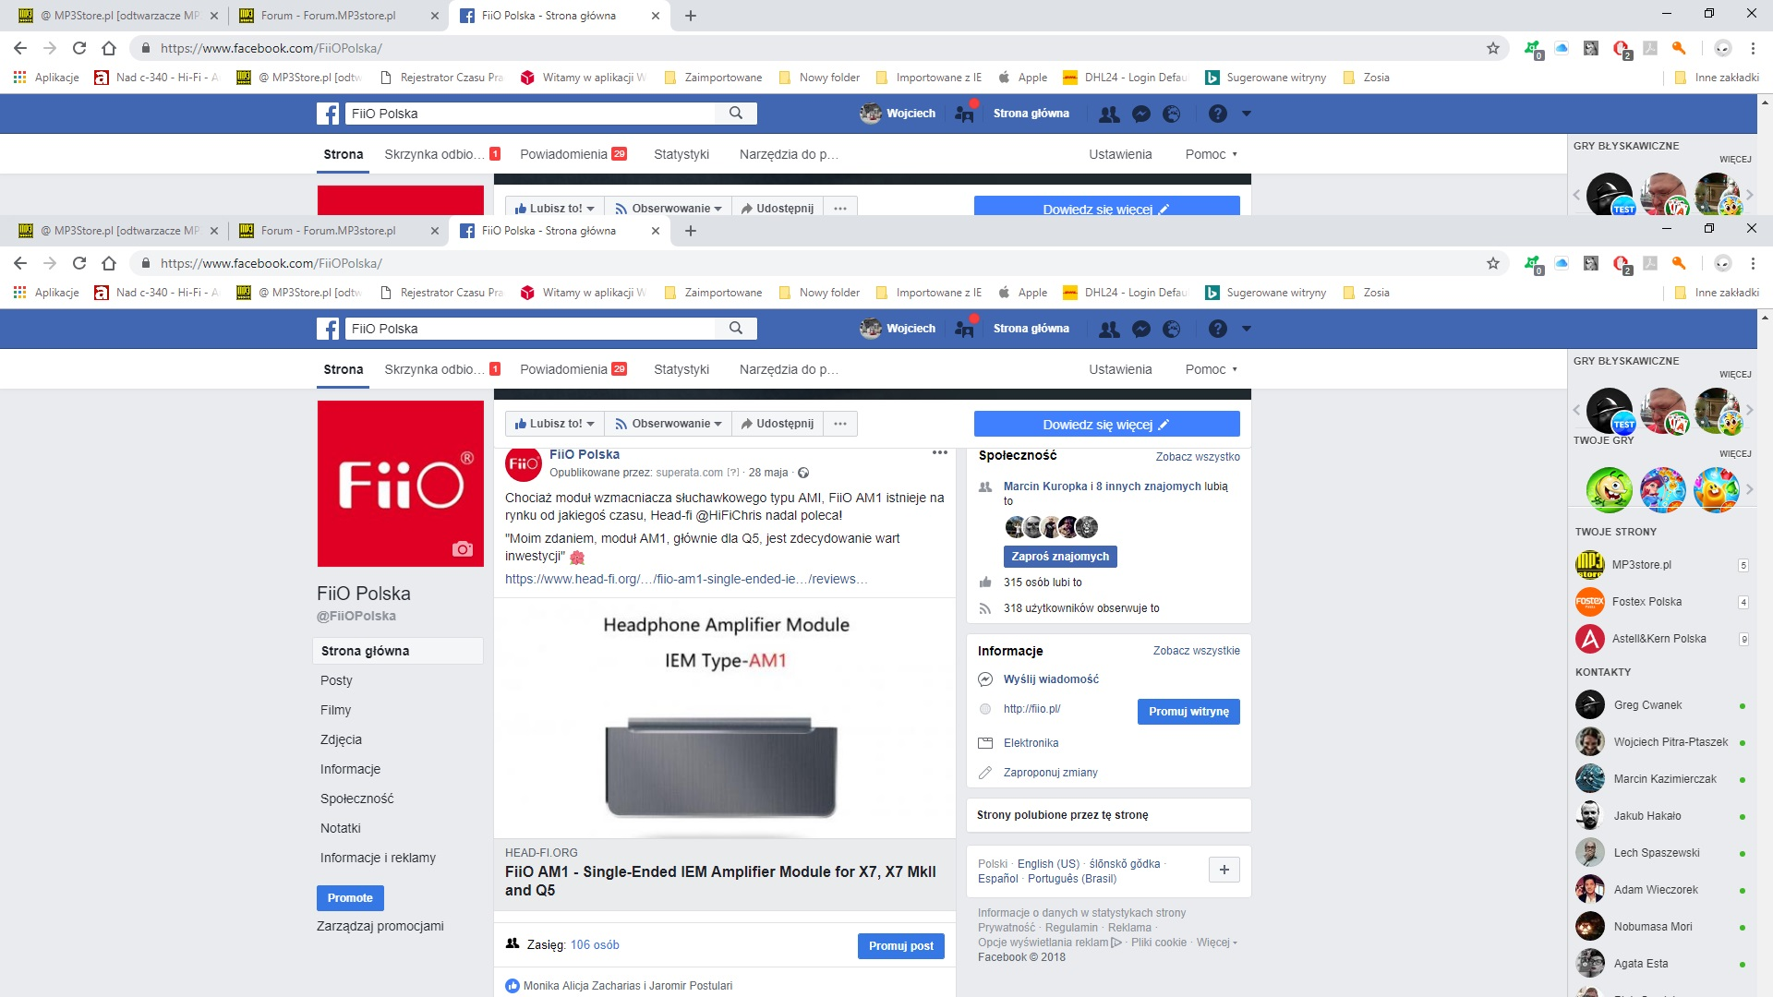
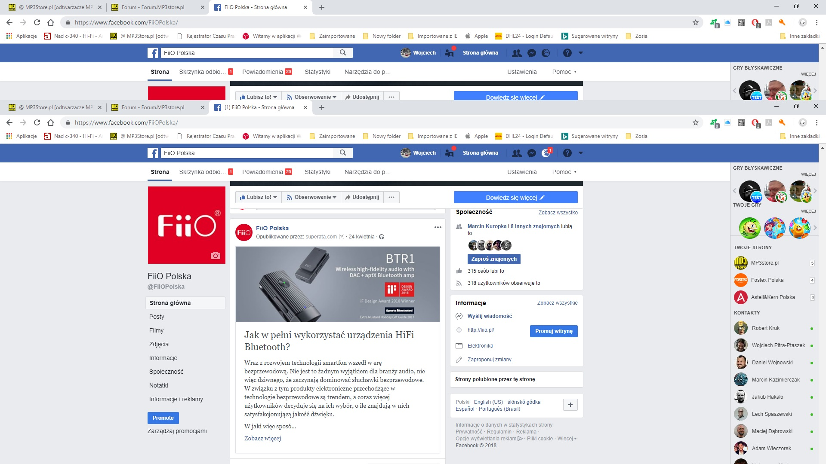
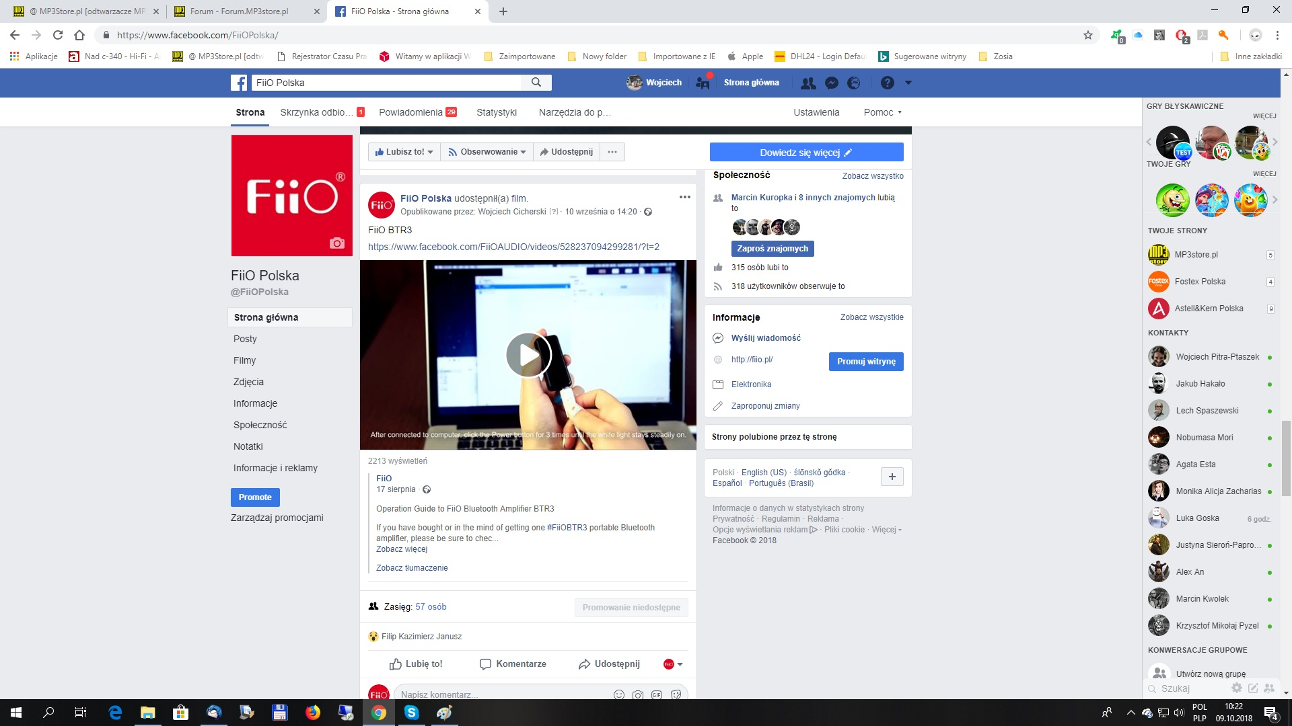
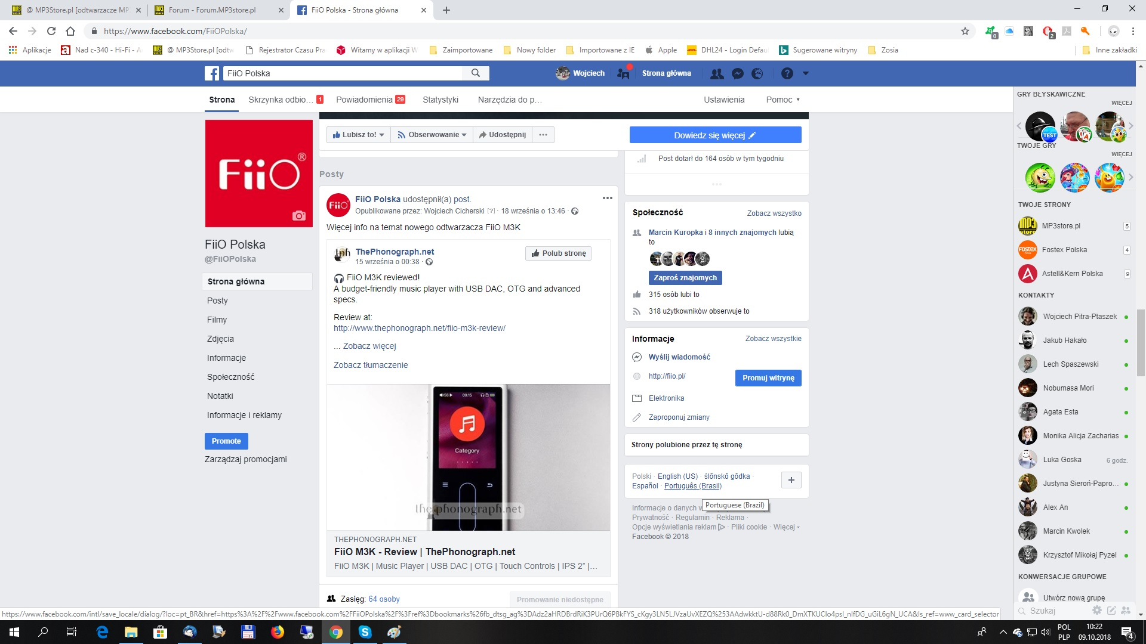
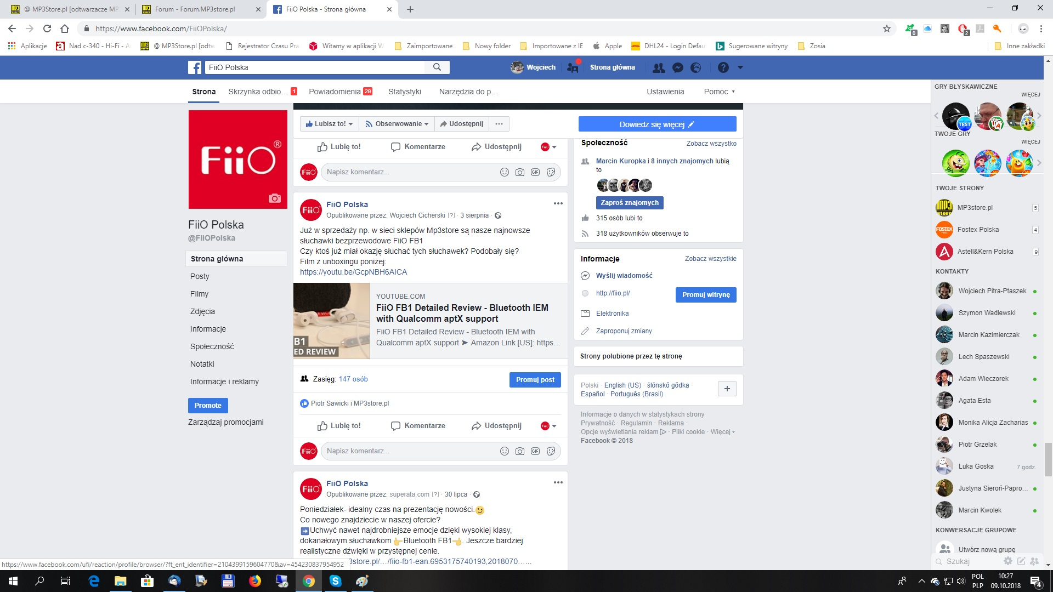
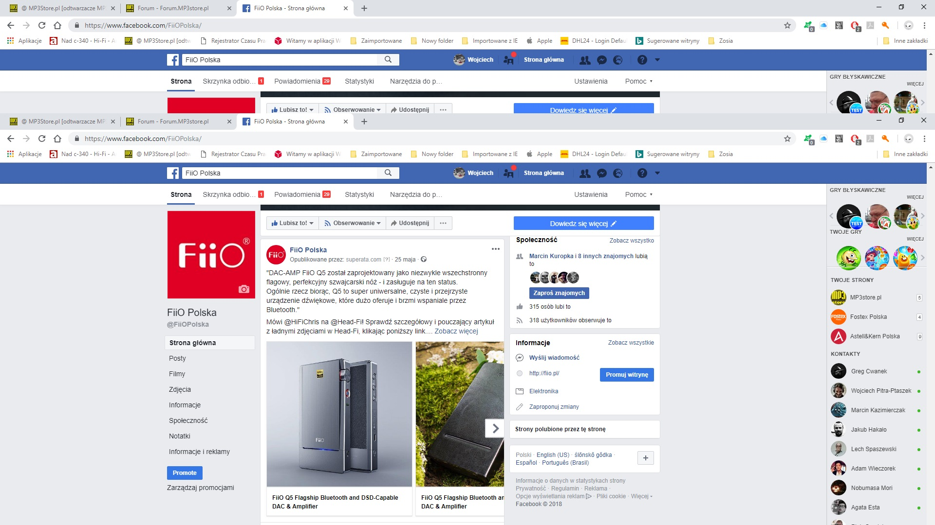
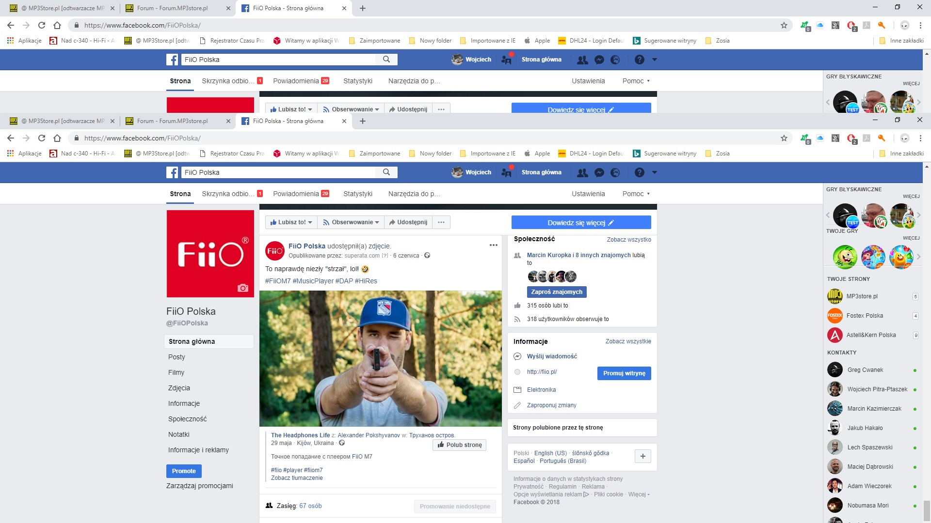
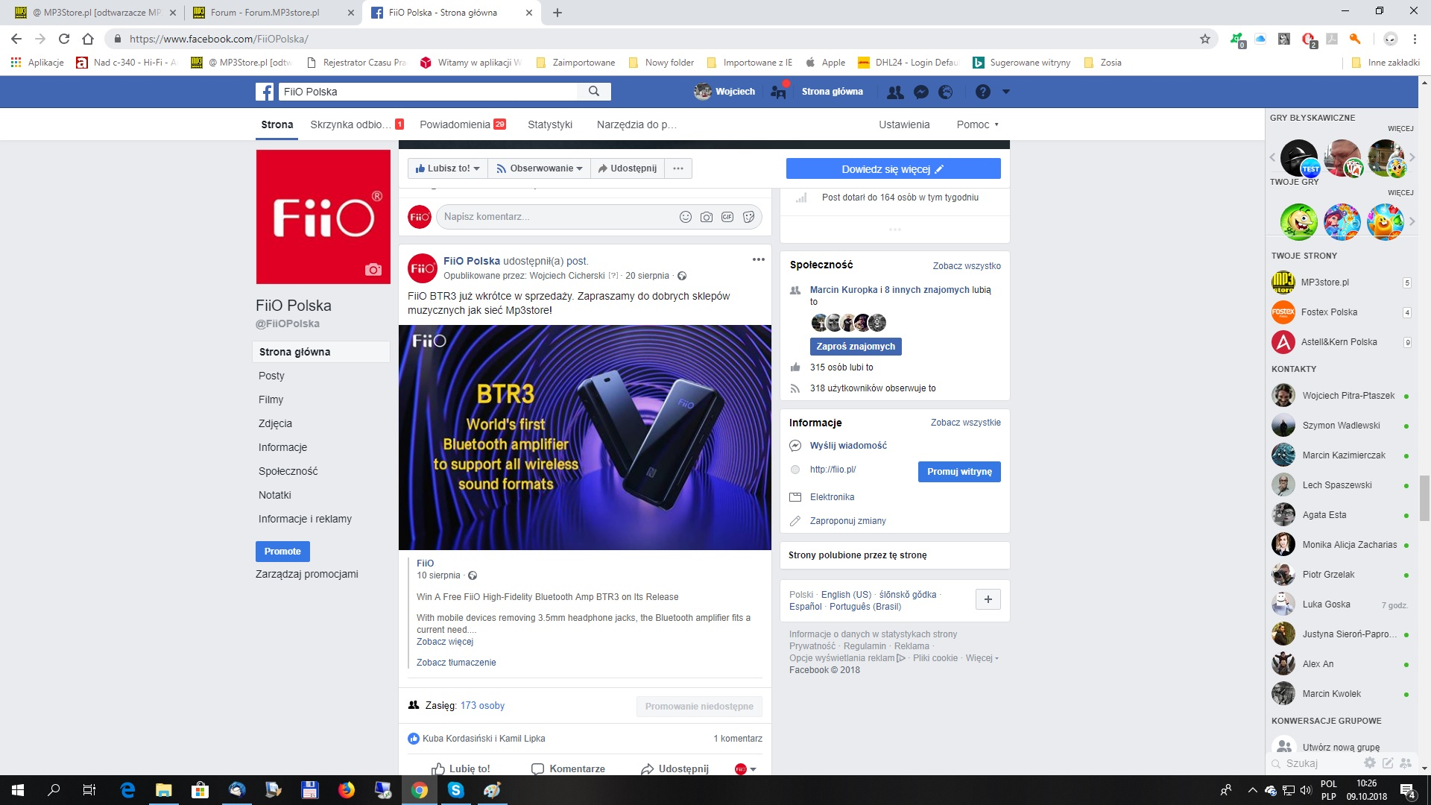
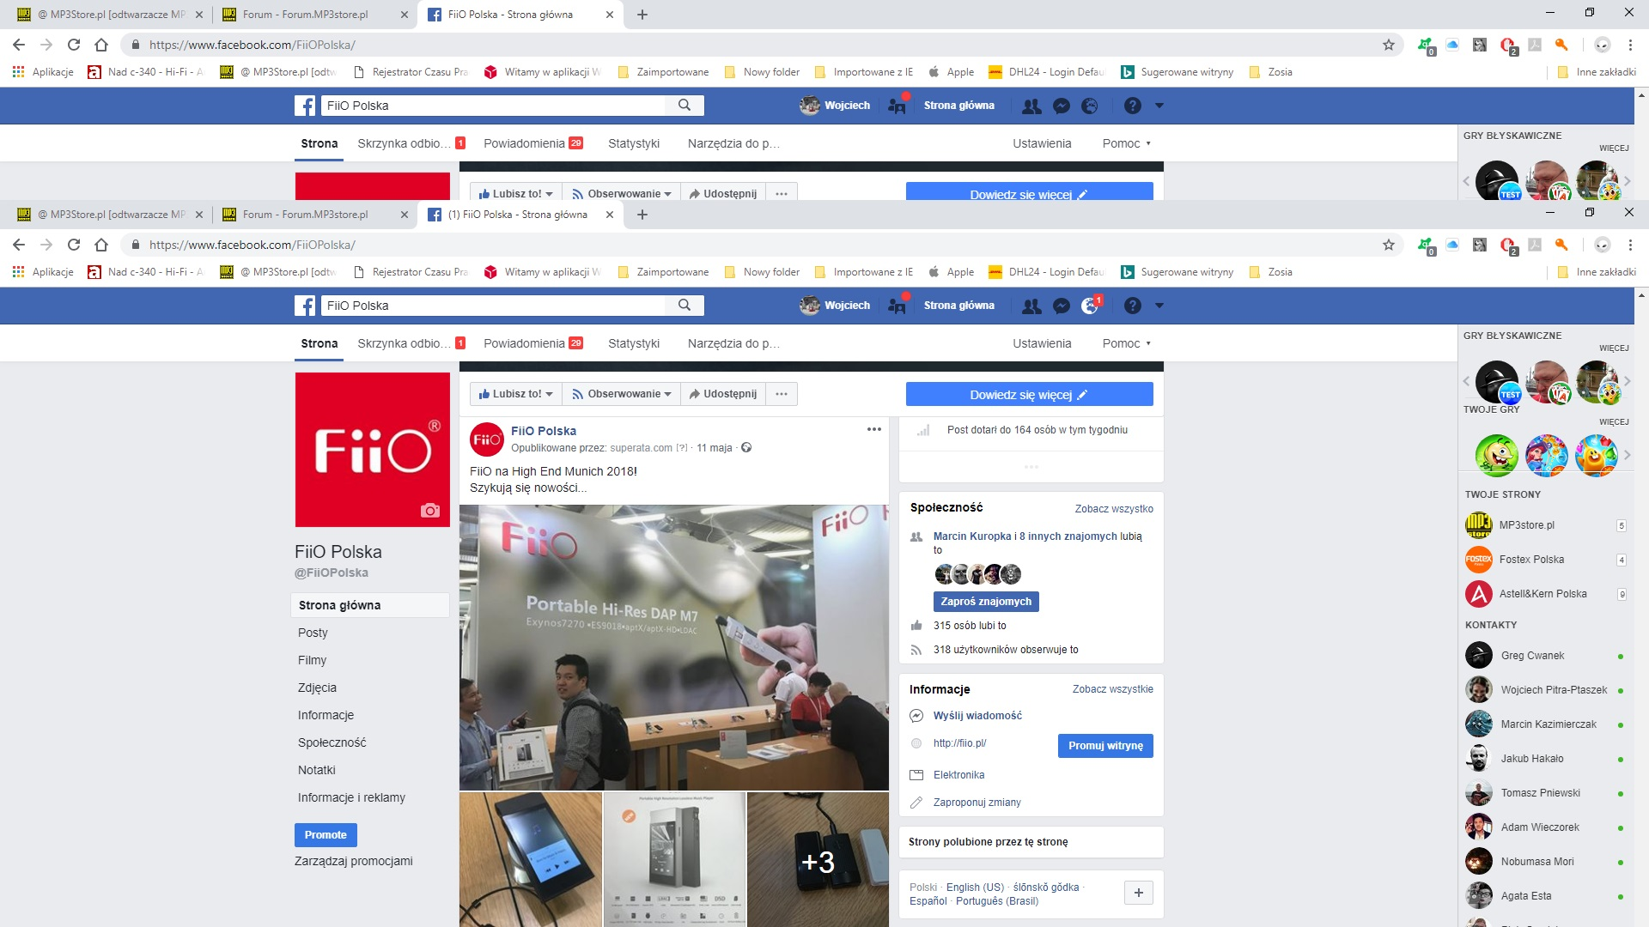
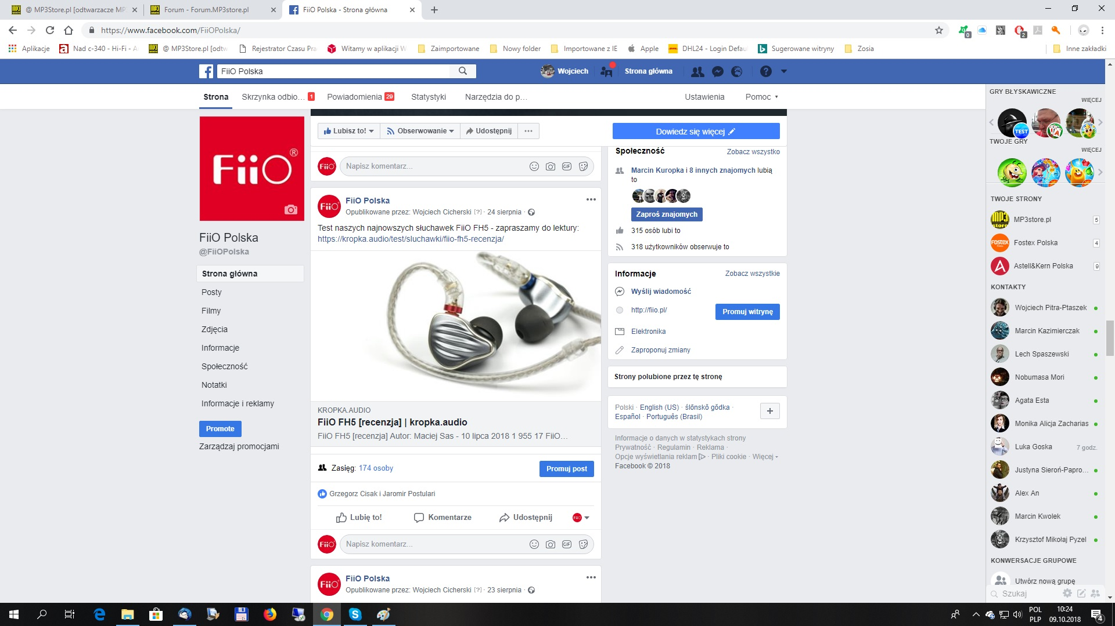
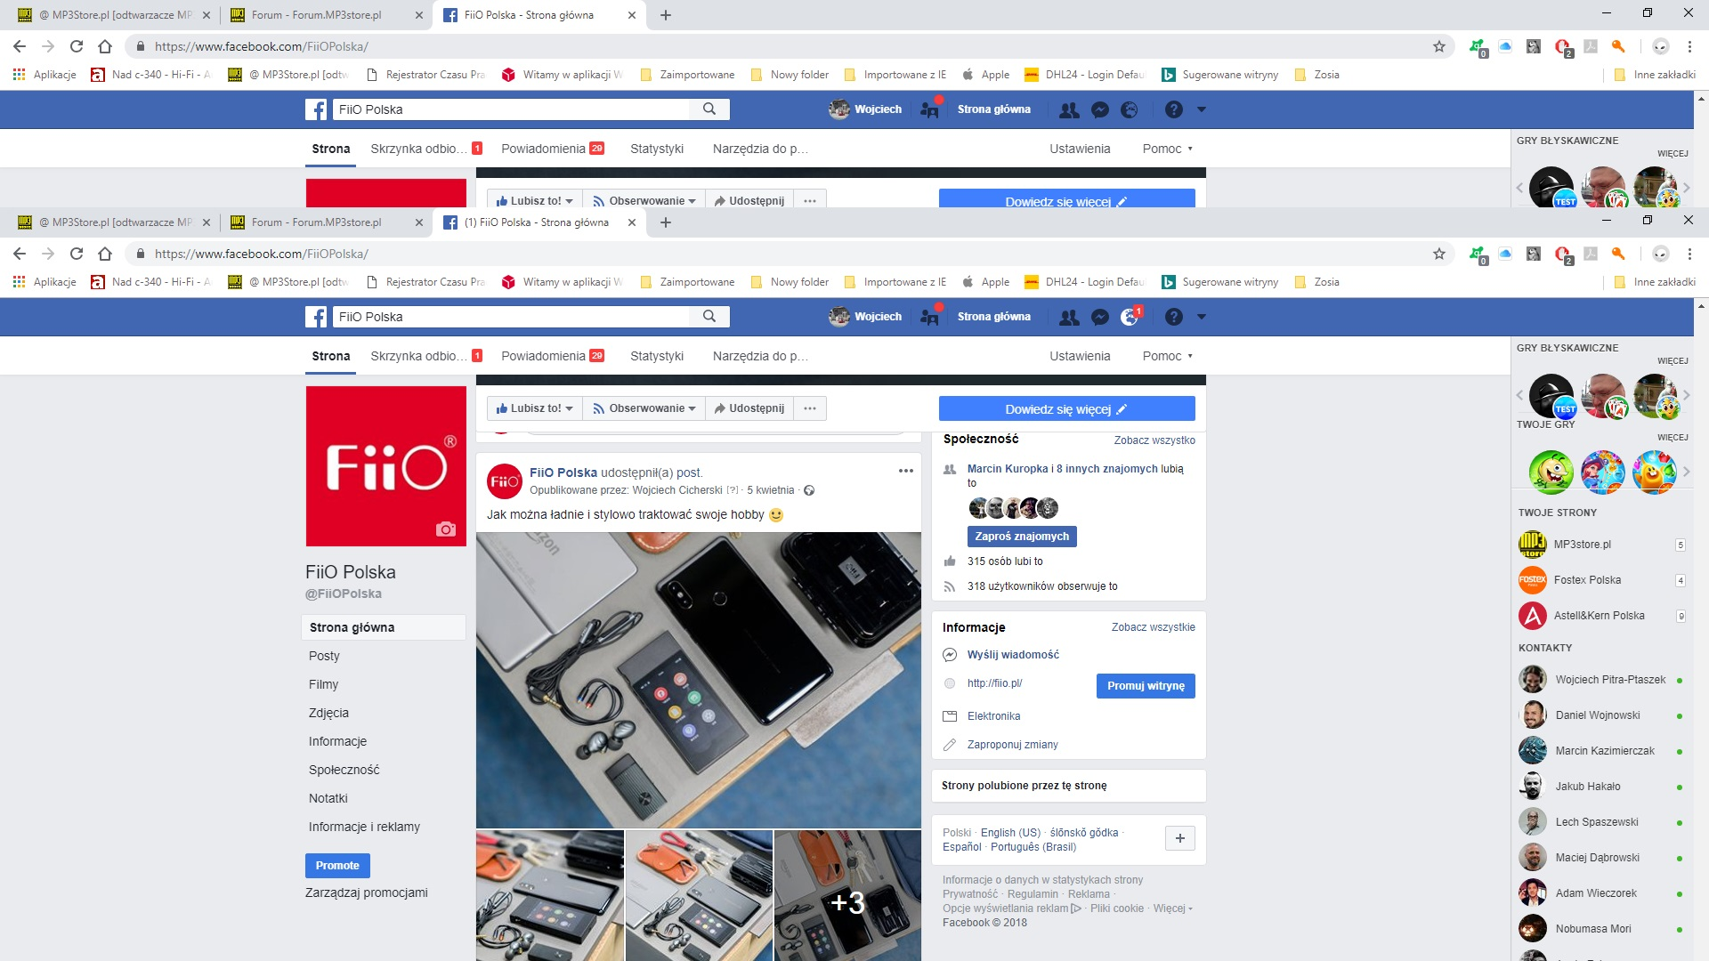
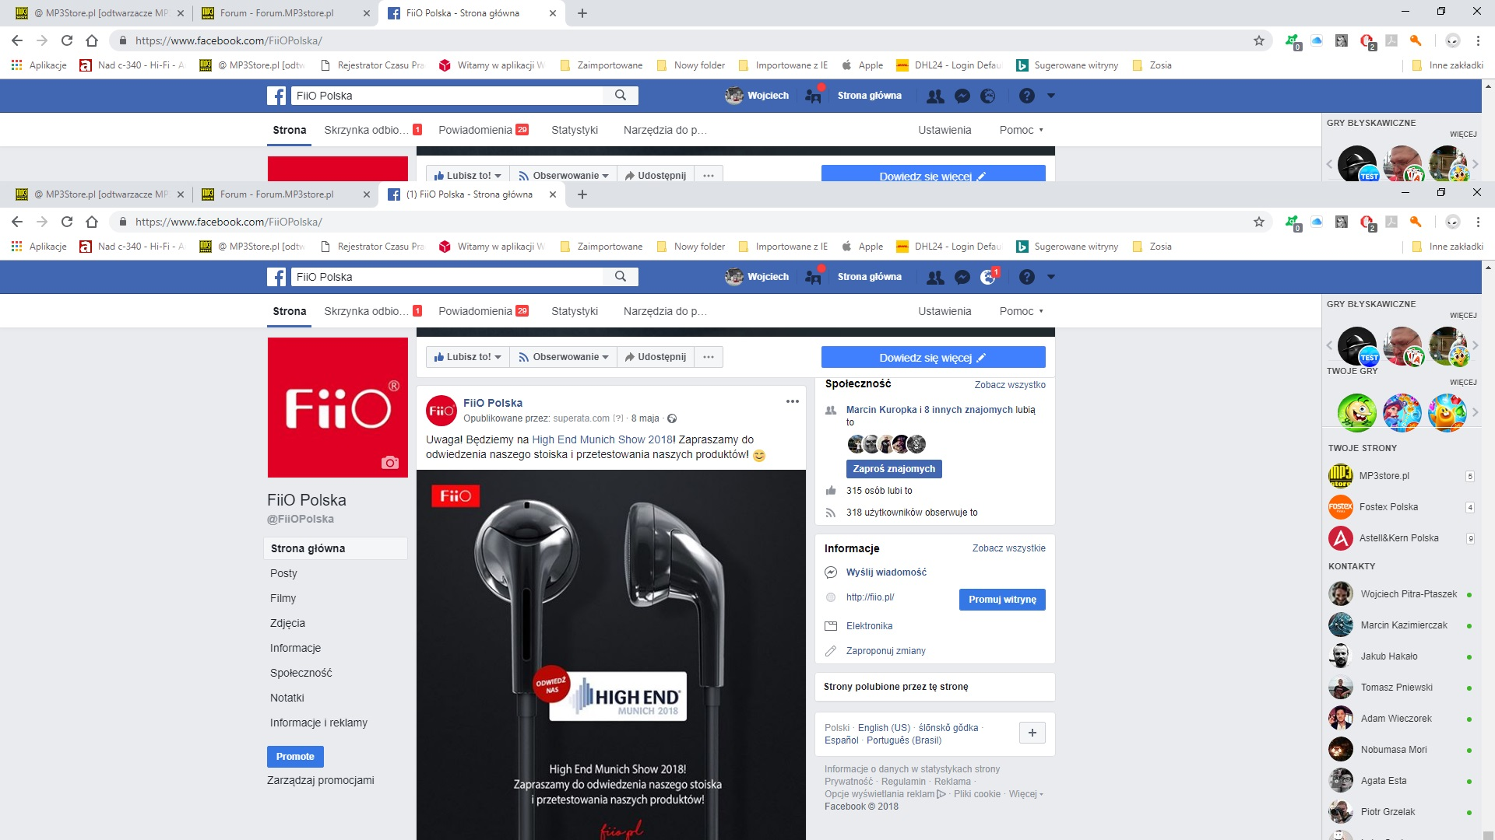
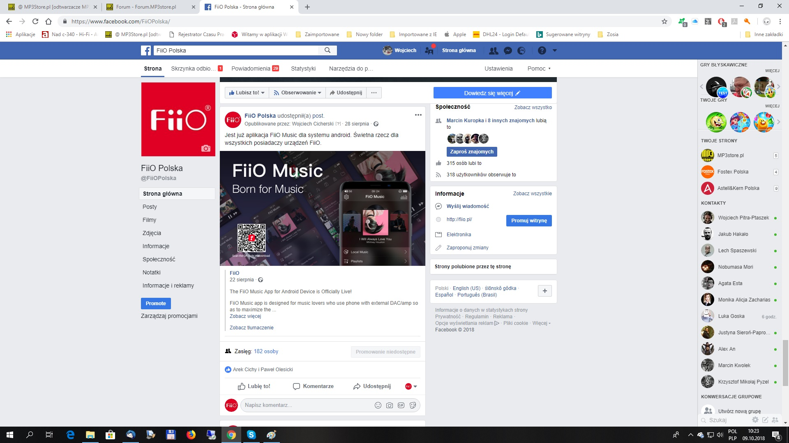
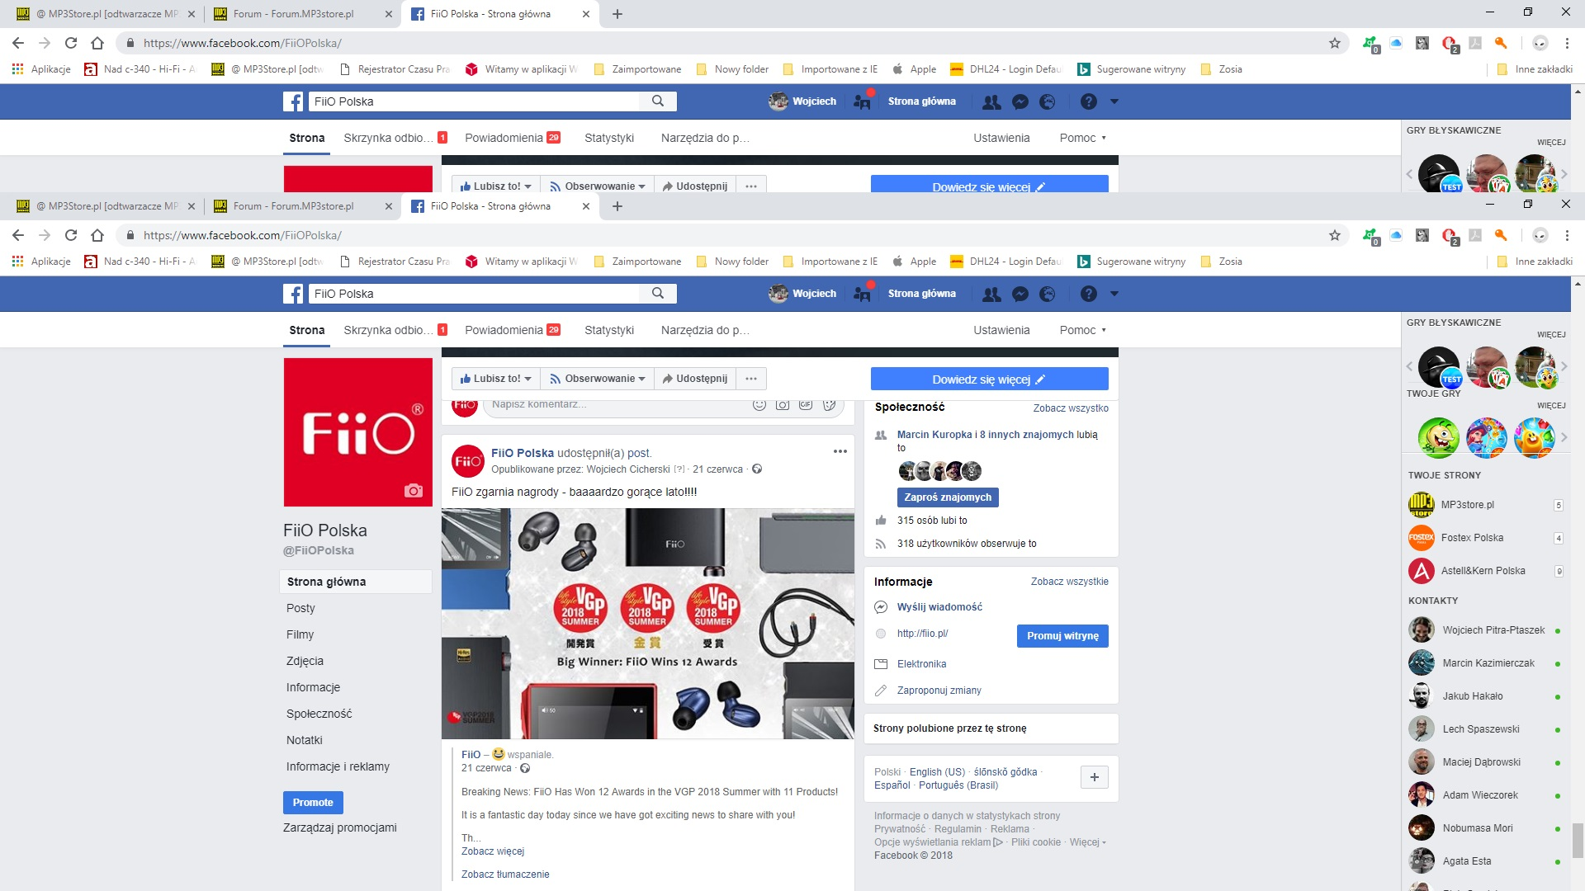
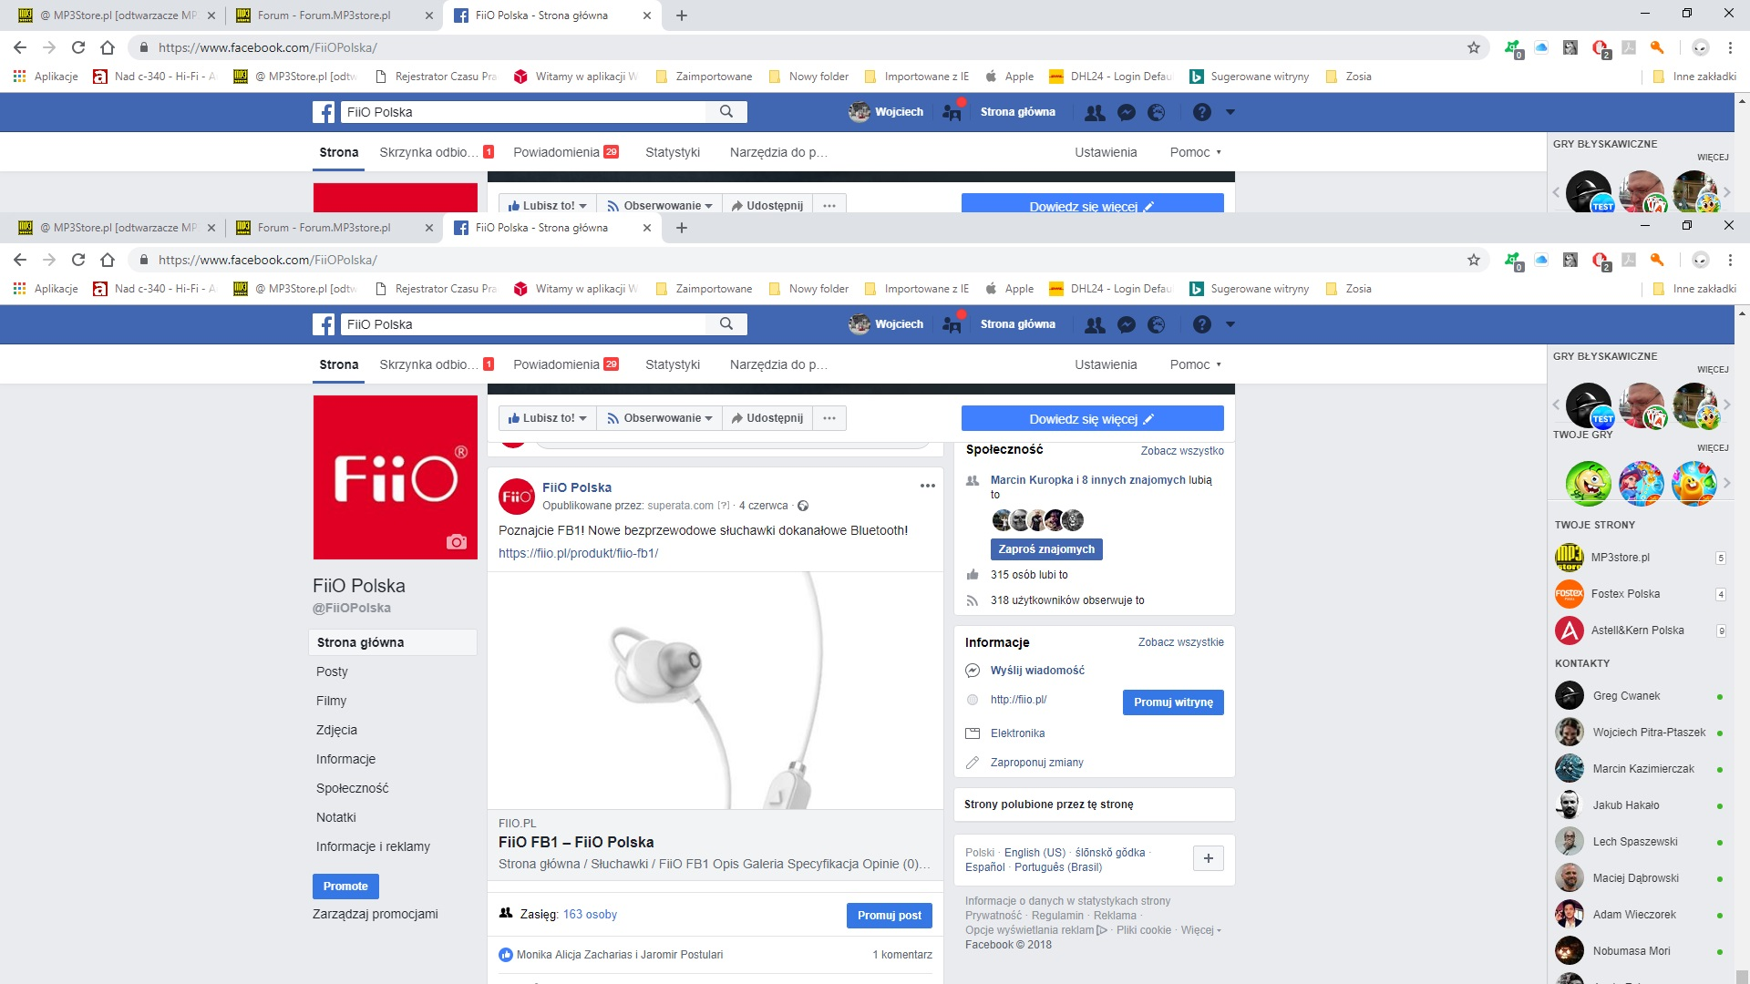
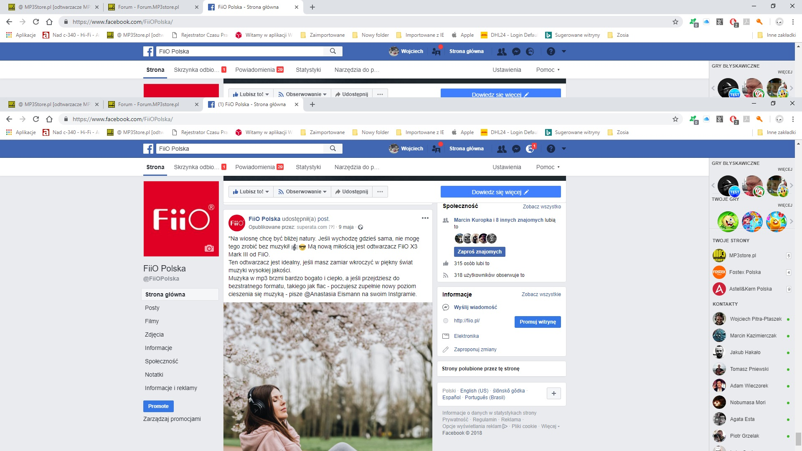
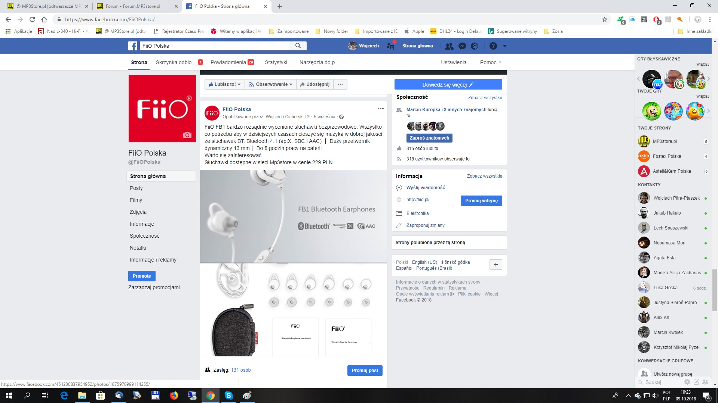
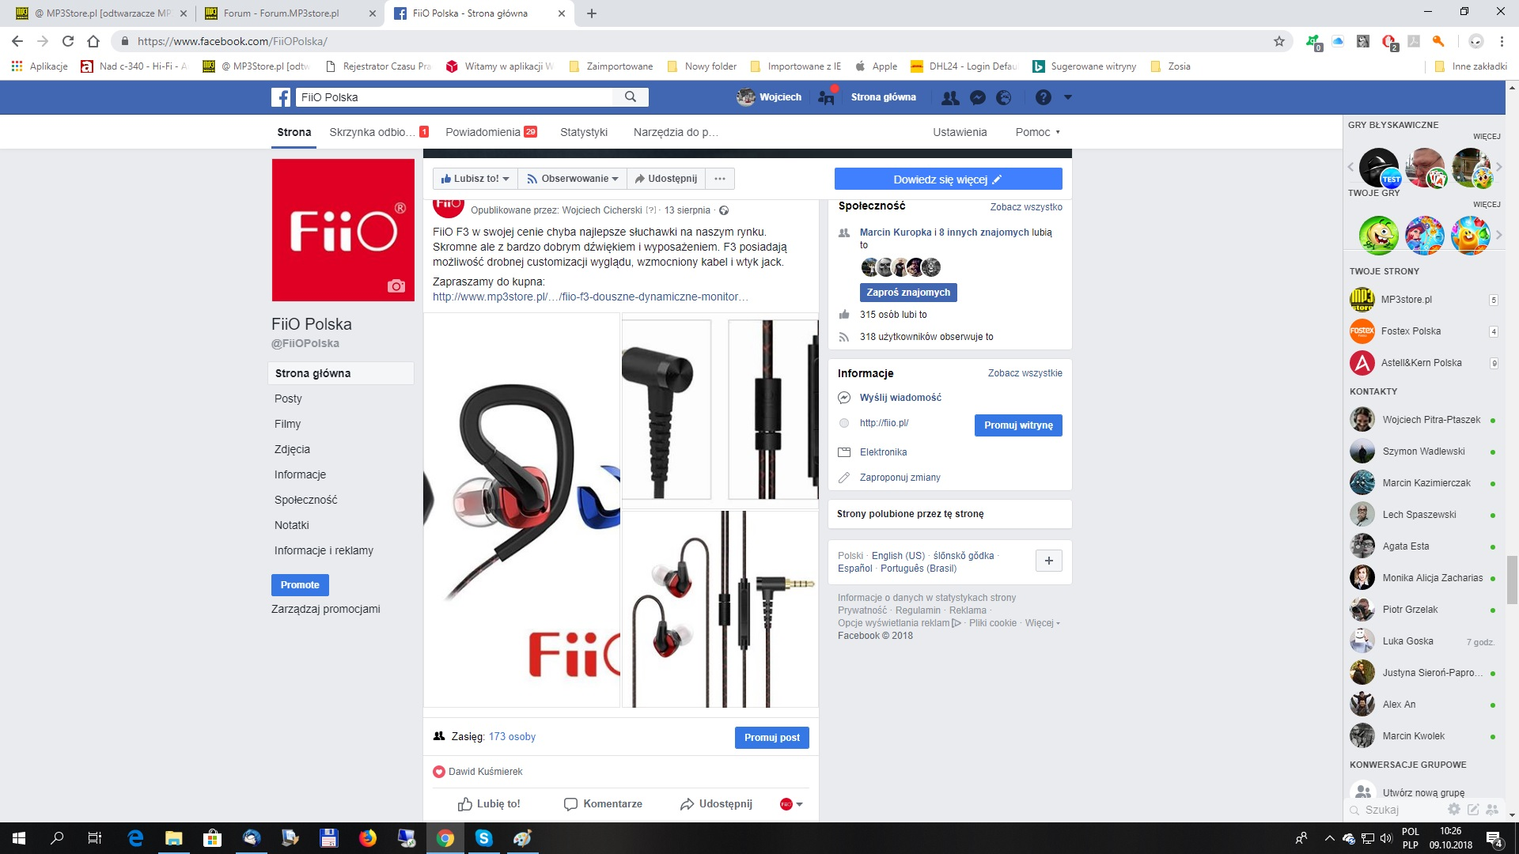
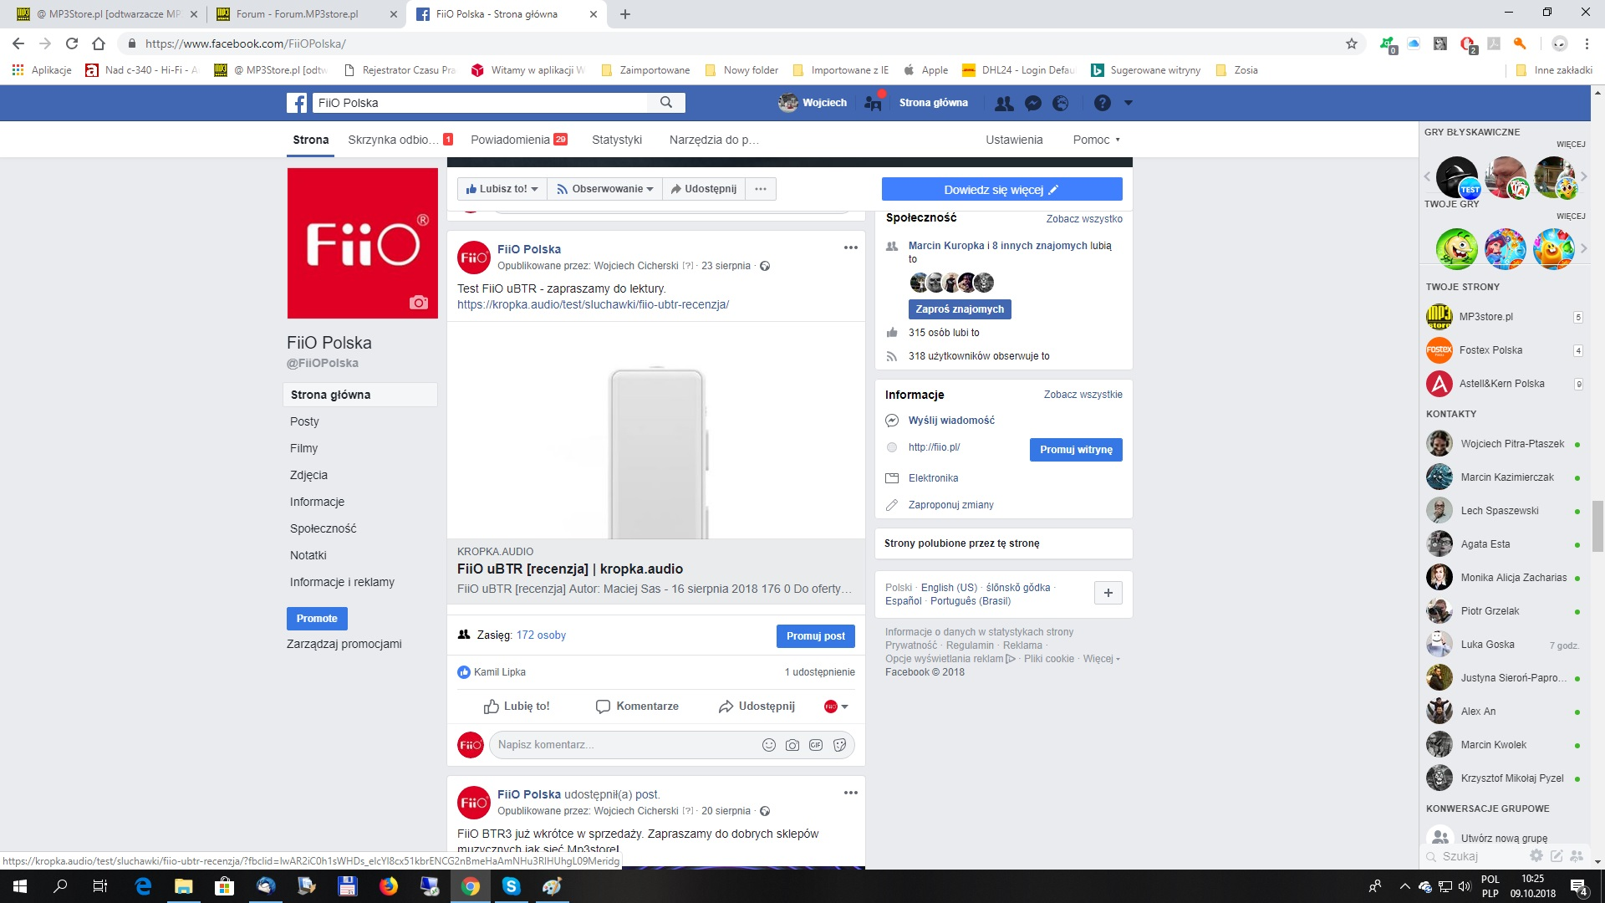
Facebook Update

Slide 4
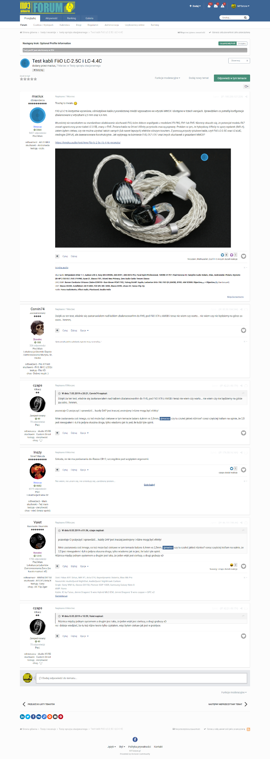
Audio Community threads about new models + published reviews from friendly portals (60k registred users)

Slide 5
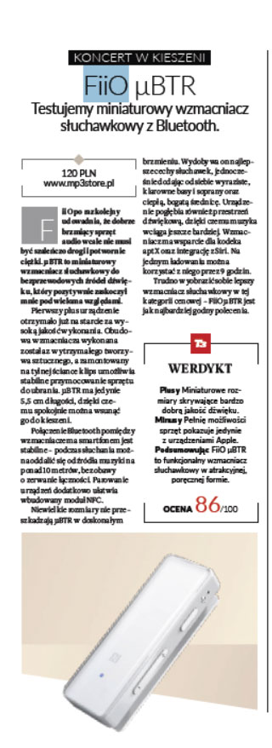
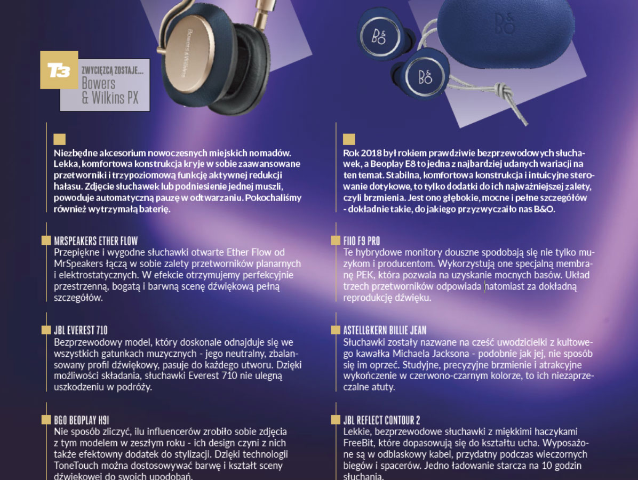
FiiO Testing

Slide 6
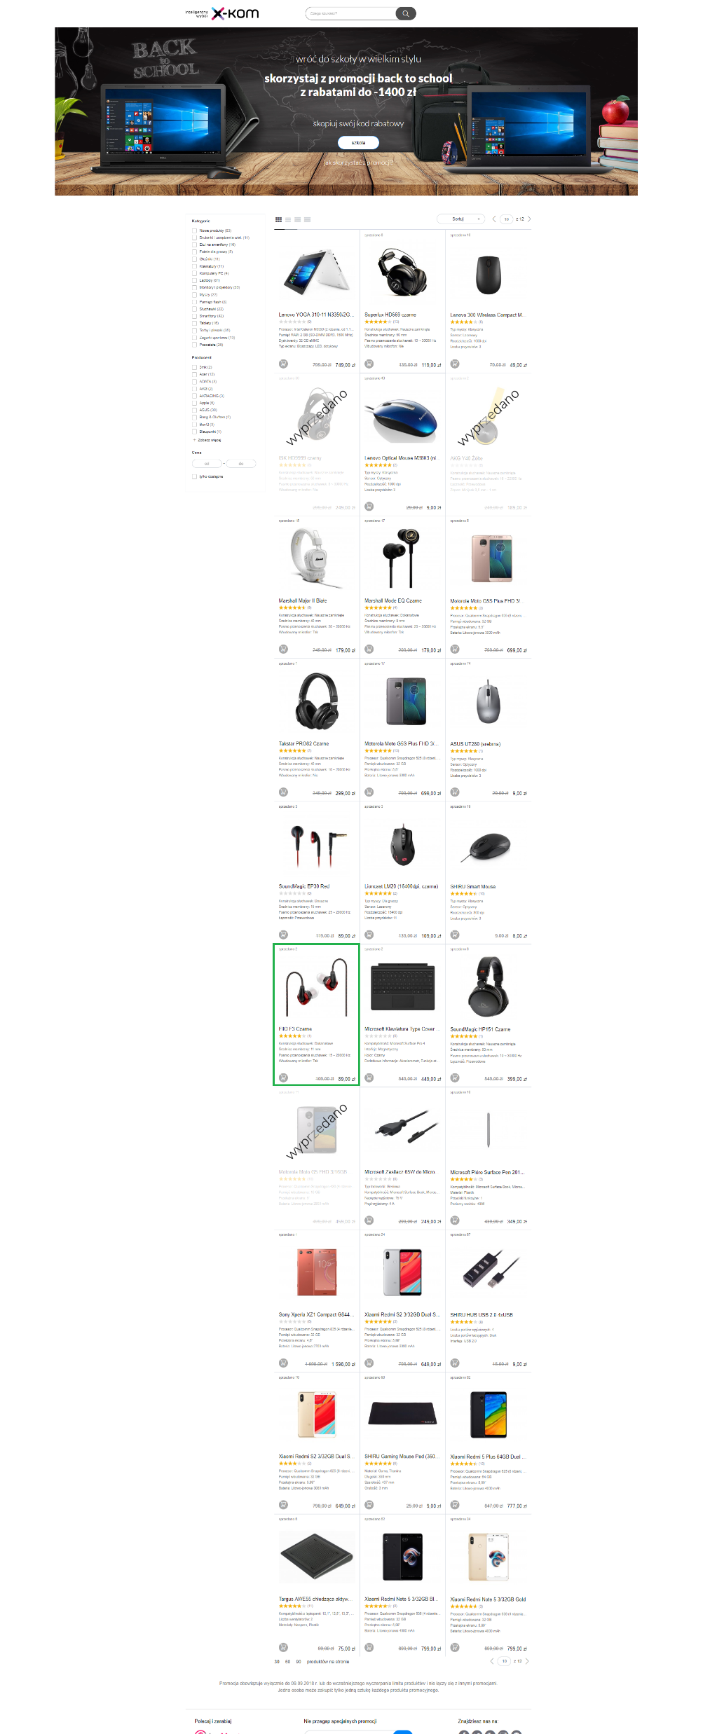
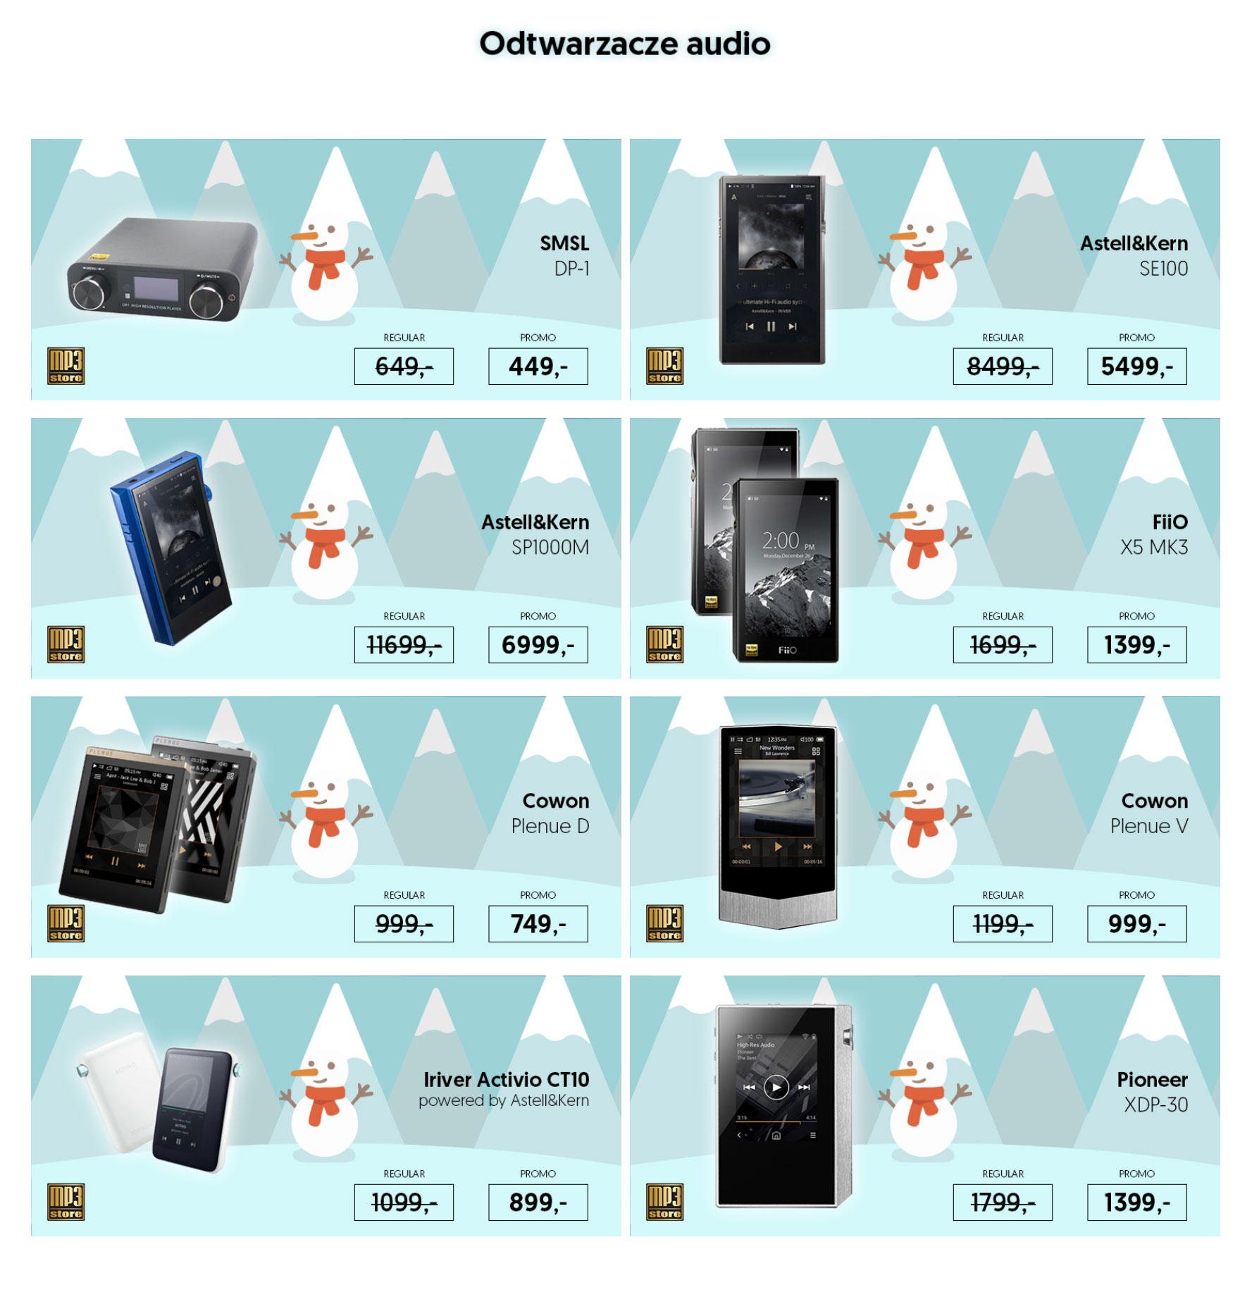
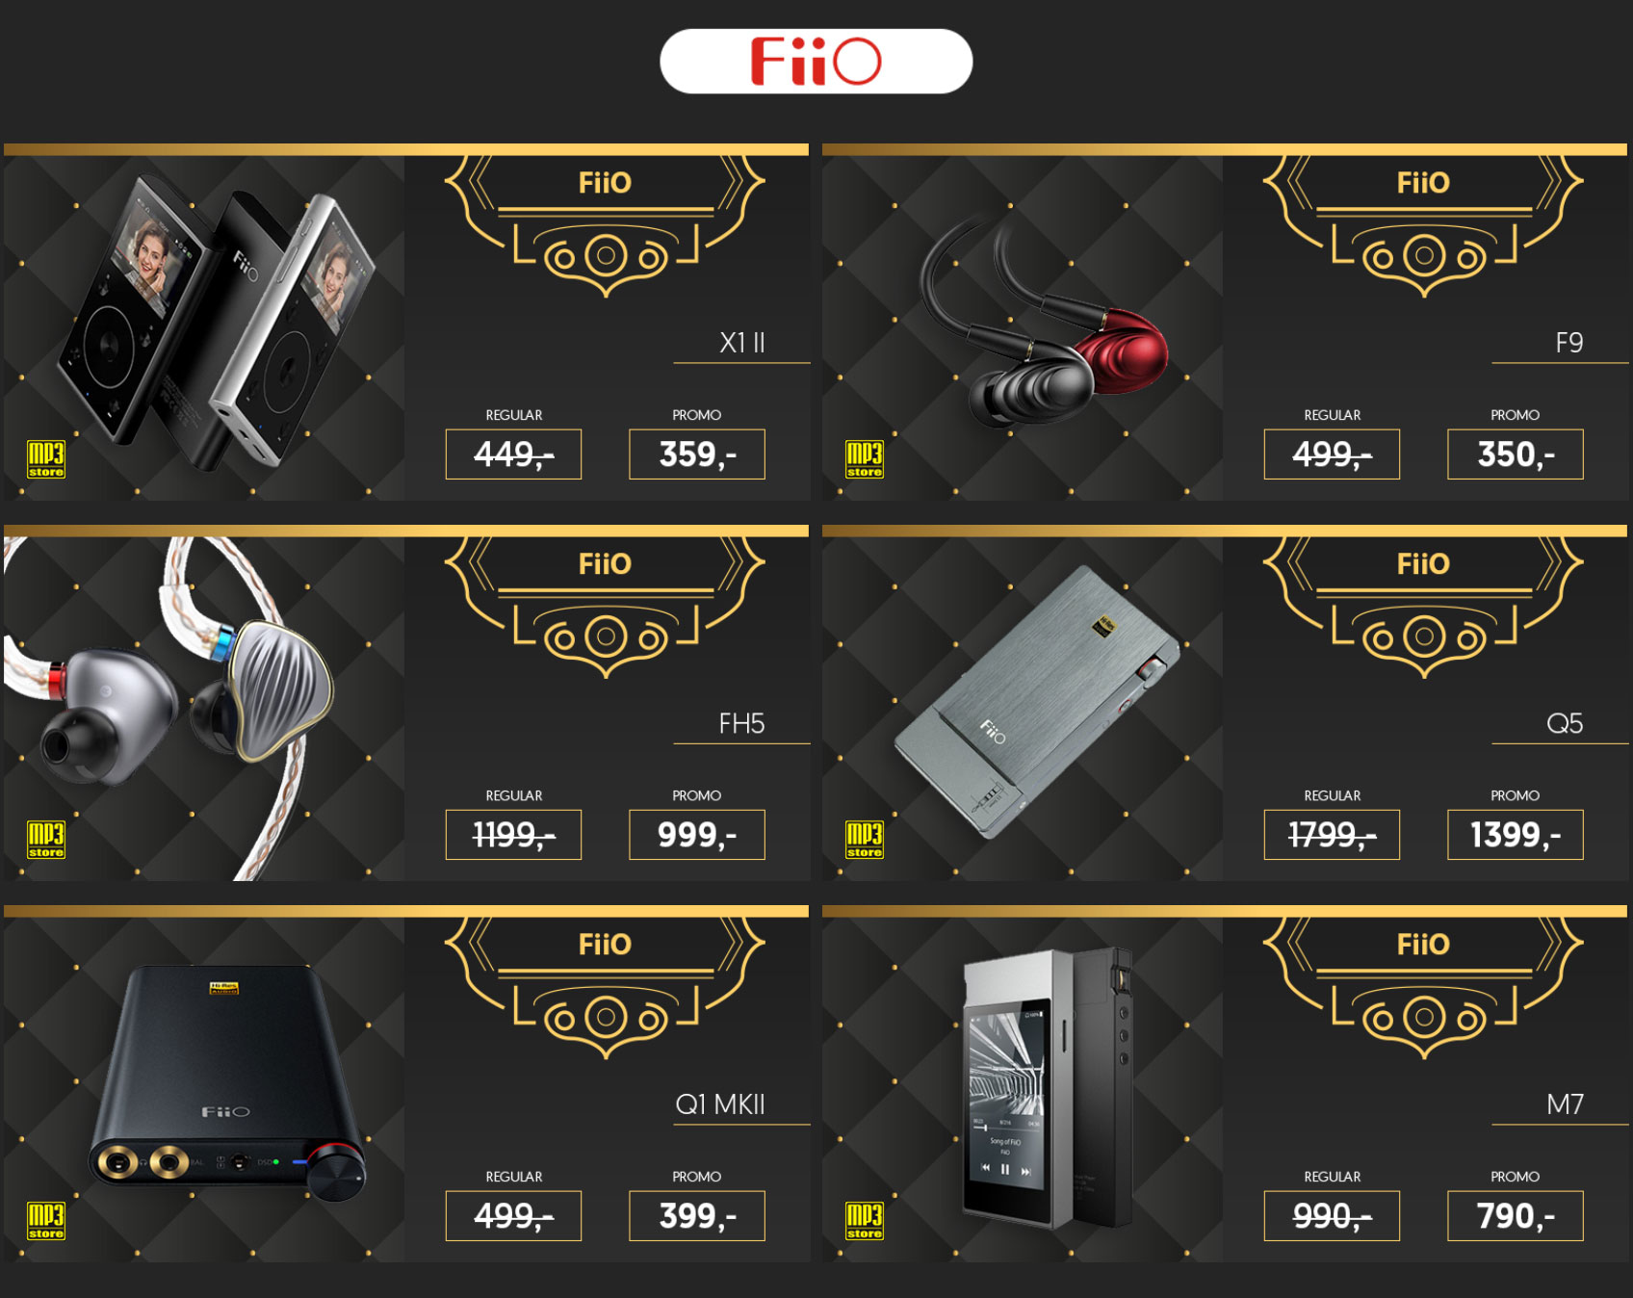
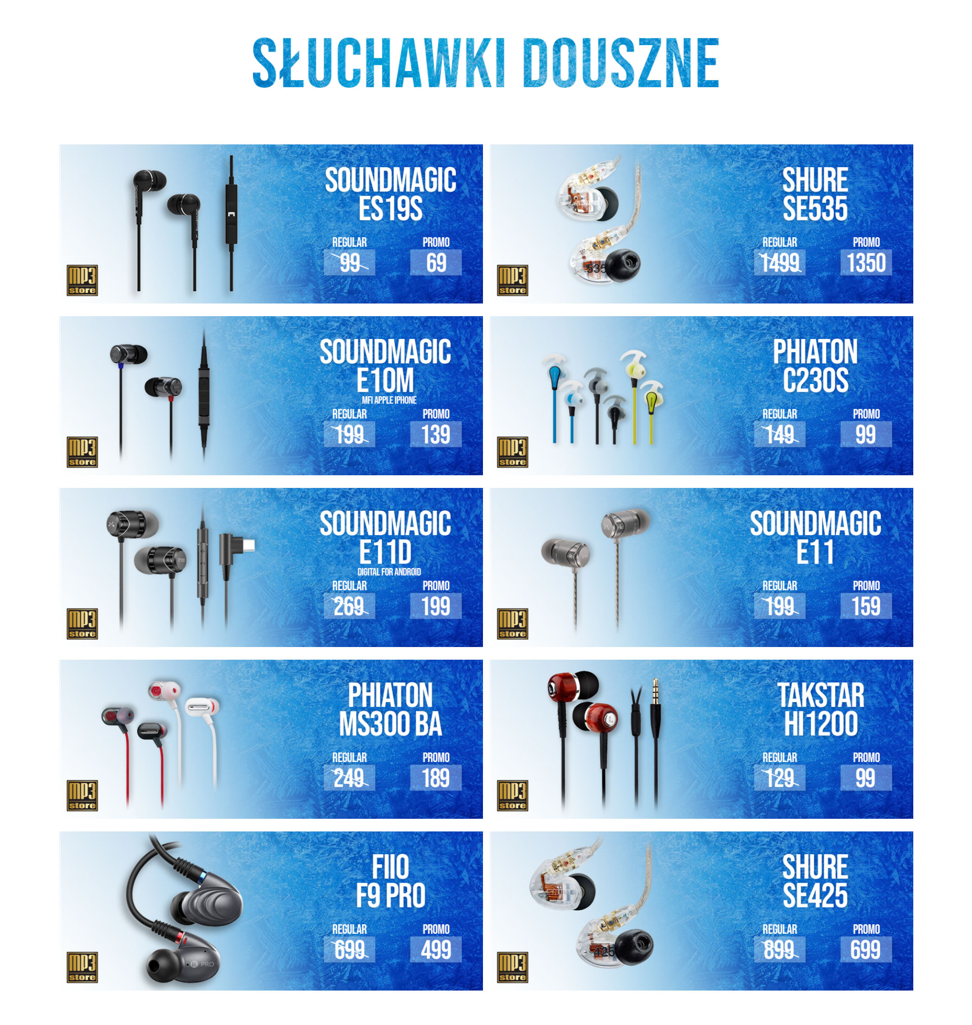
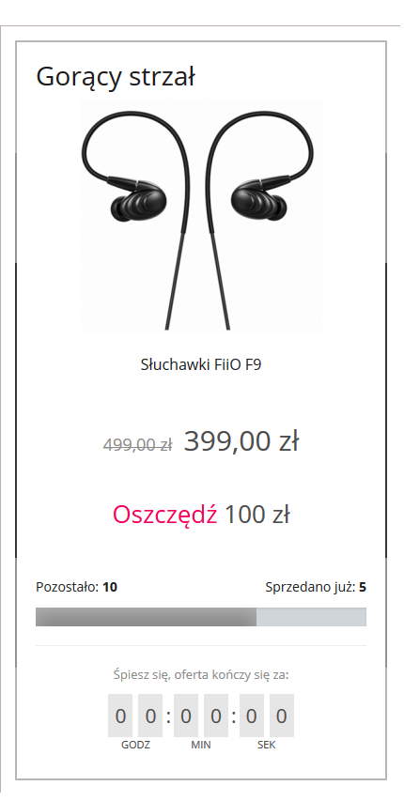
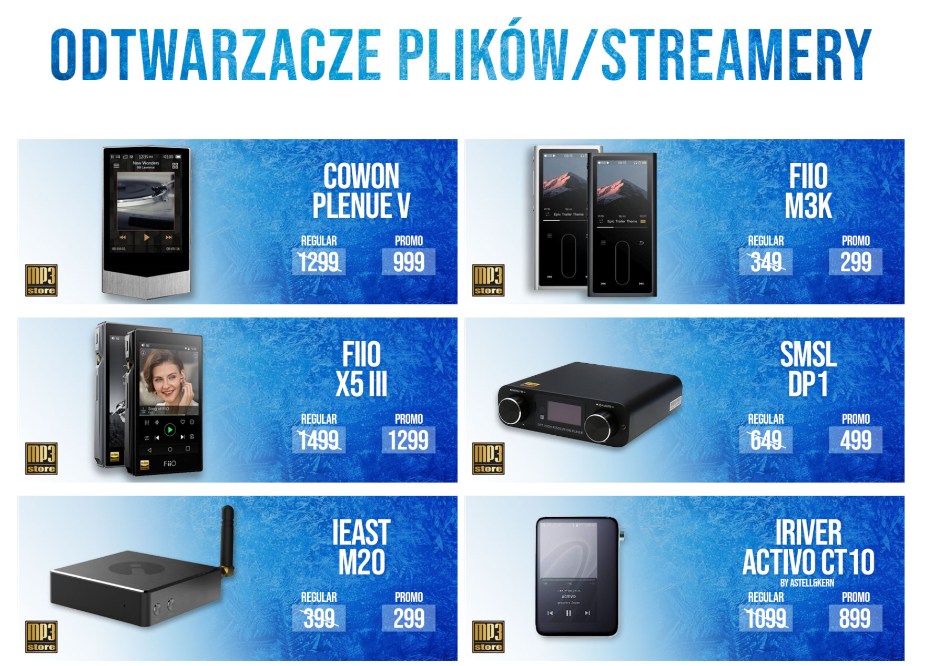
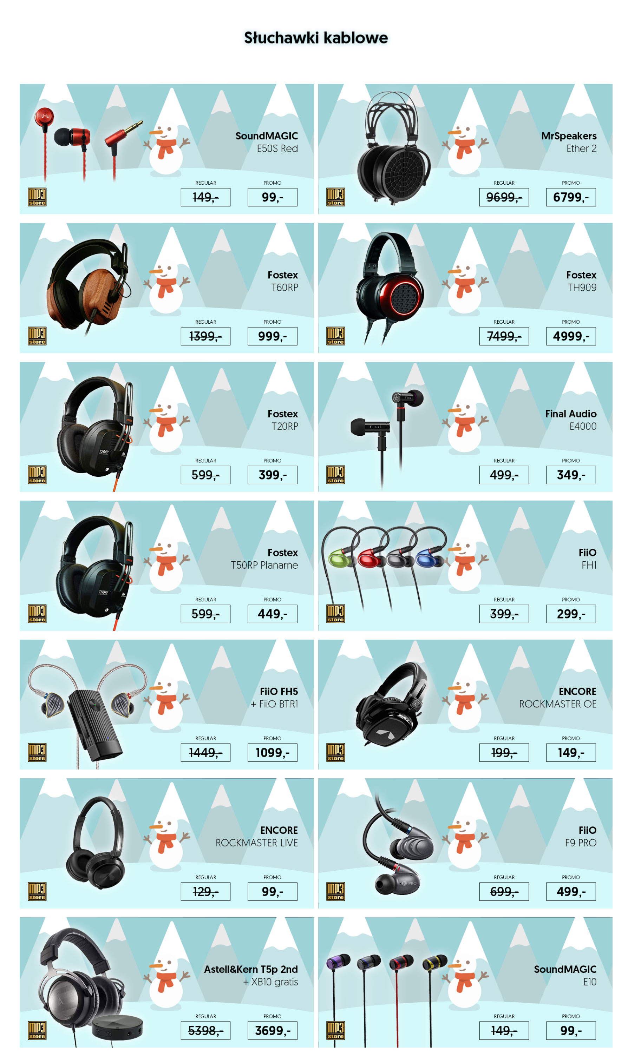
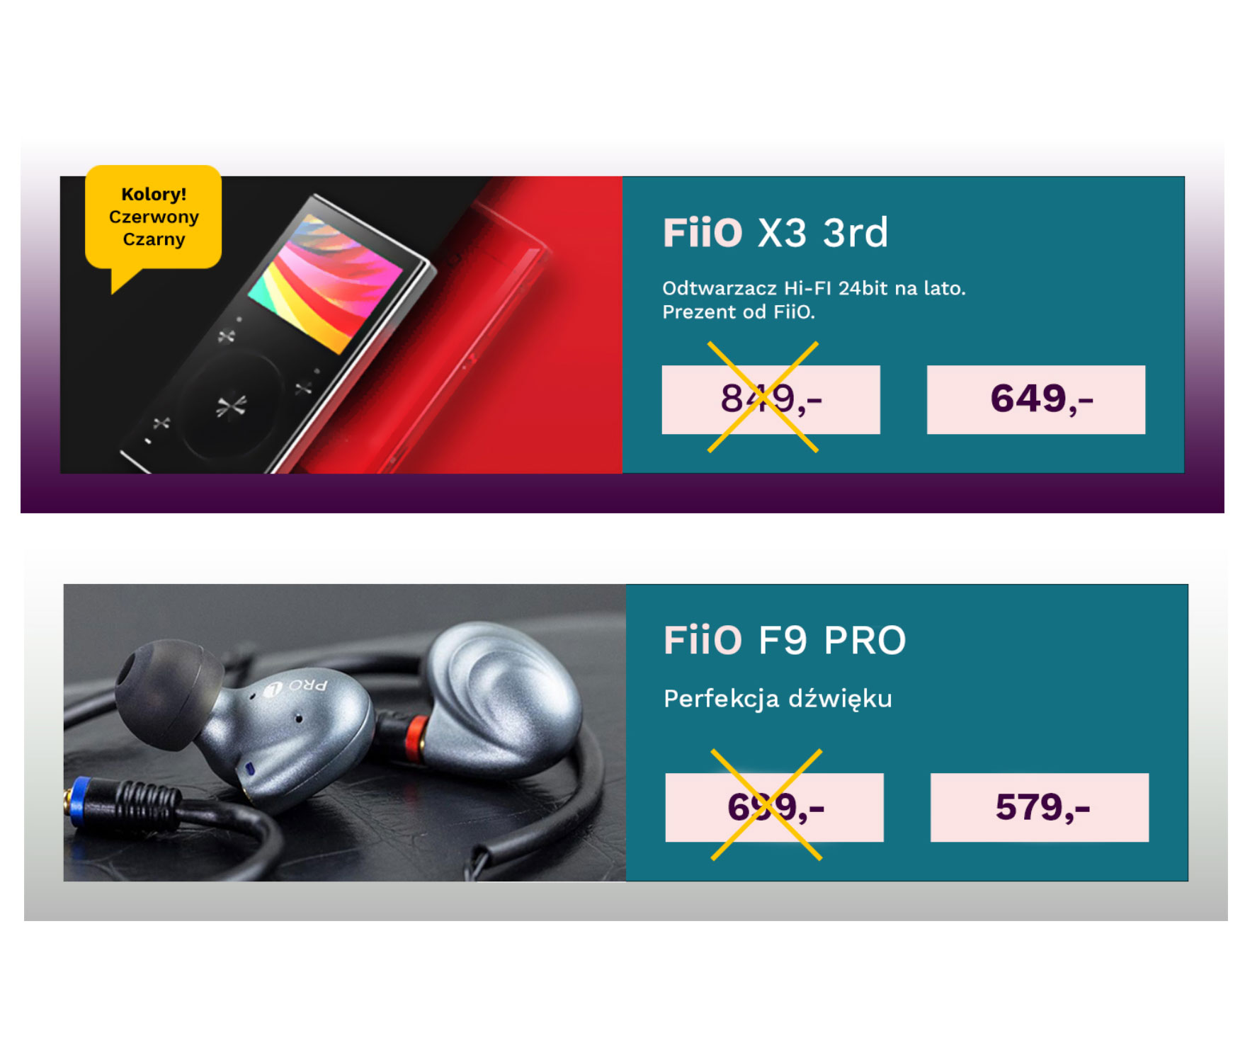
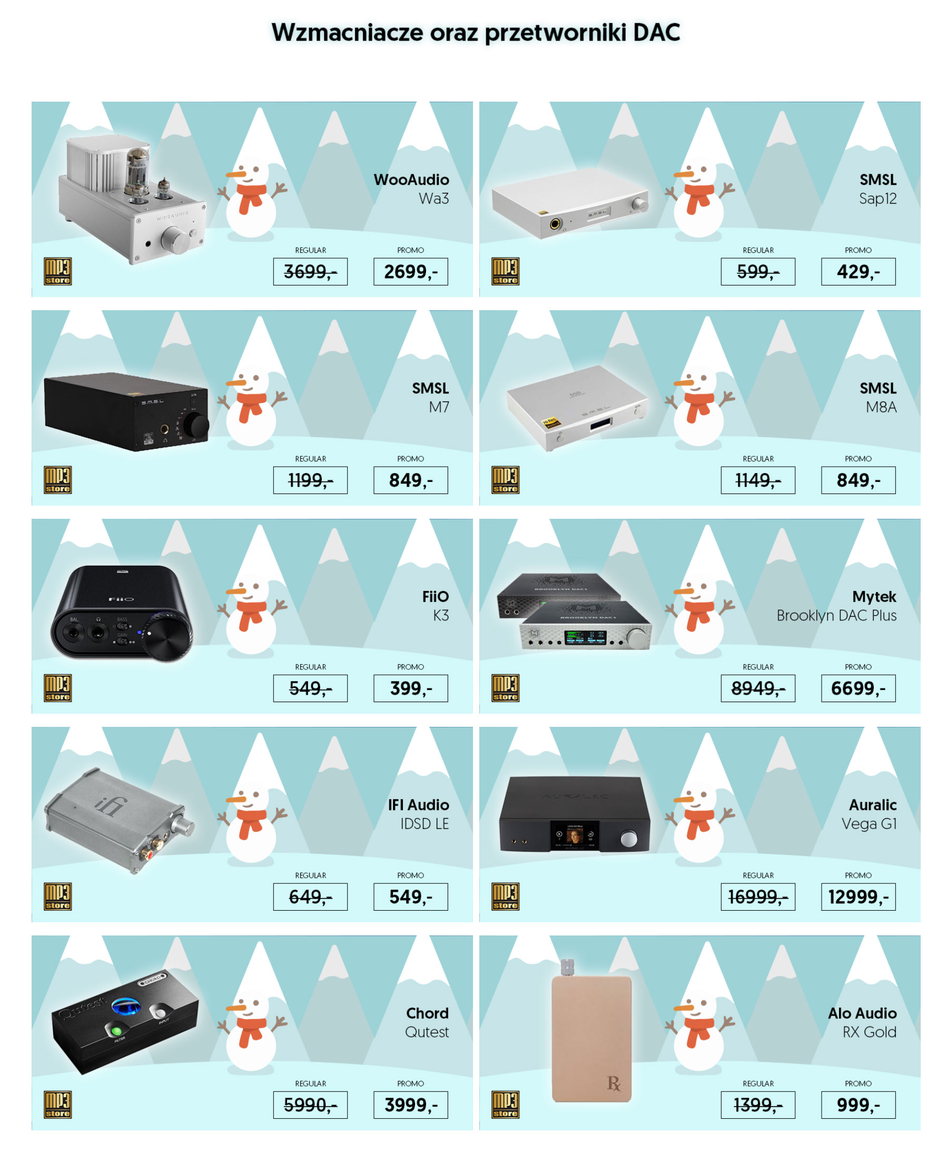
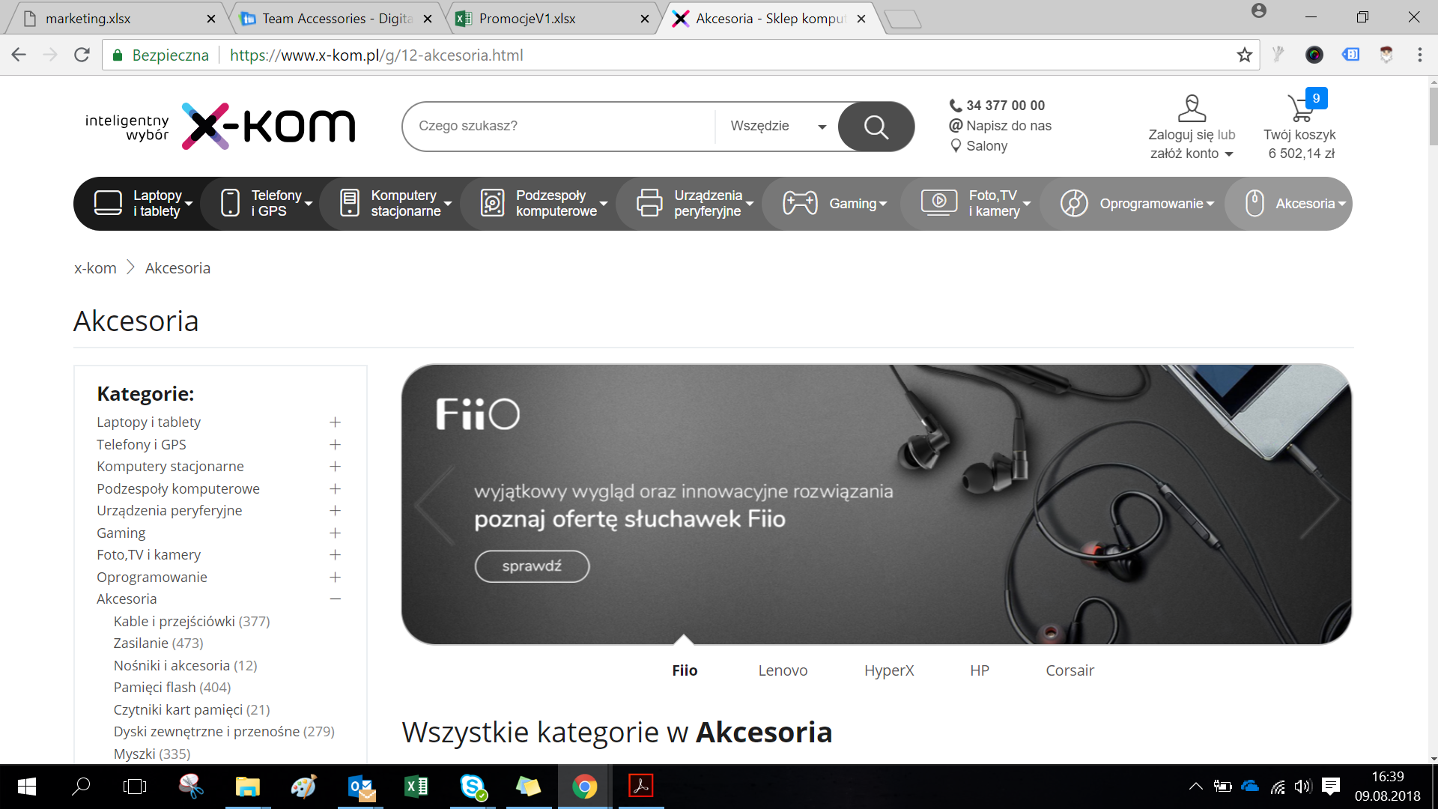
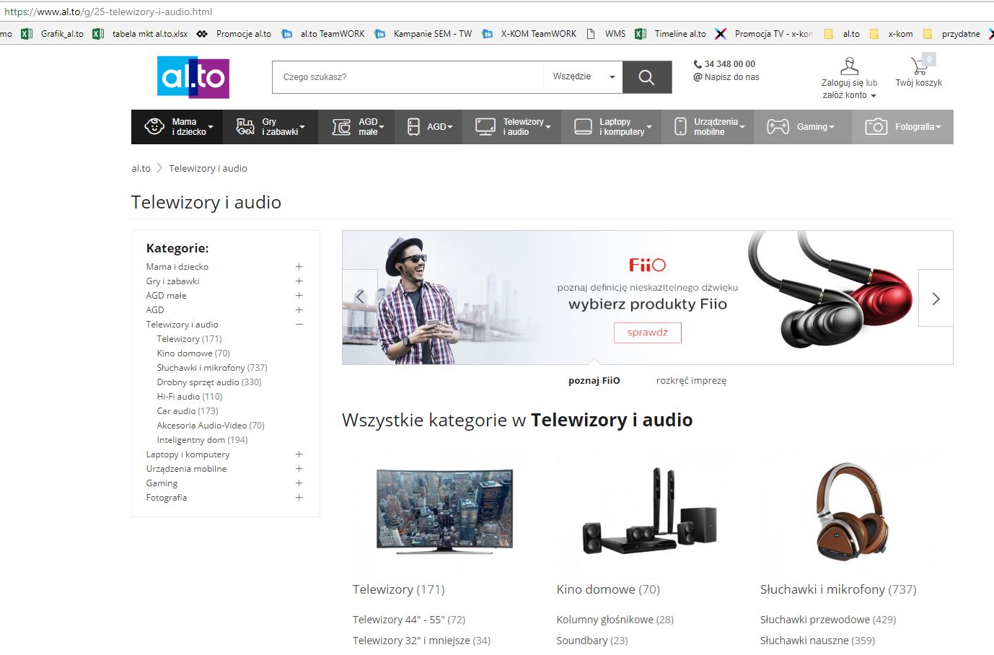
Examples of Occasional Promotional Activities
Audio Exhibition Promotion
Winter Promotion
Xcom promotion
Special offer at dealers
Presales in Audio Community

Slide 7
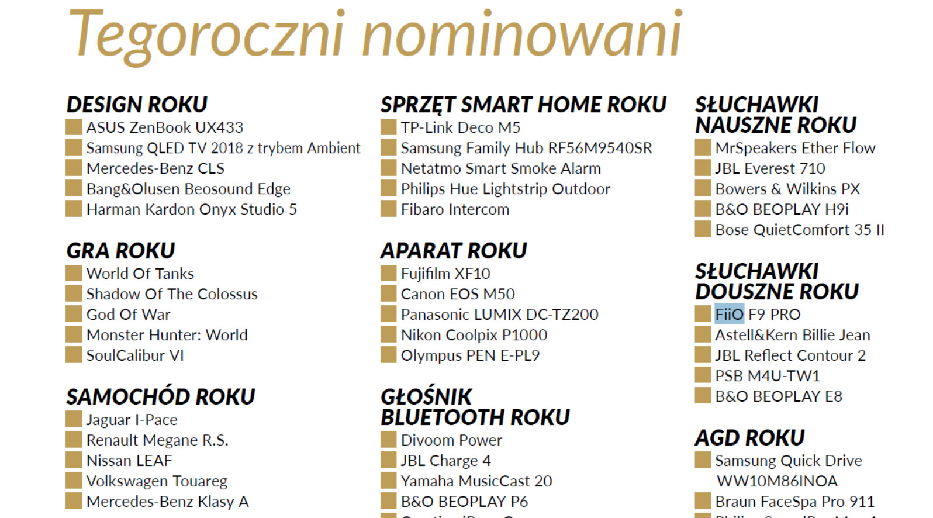
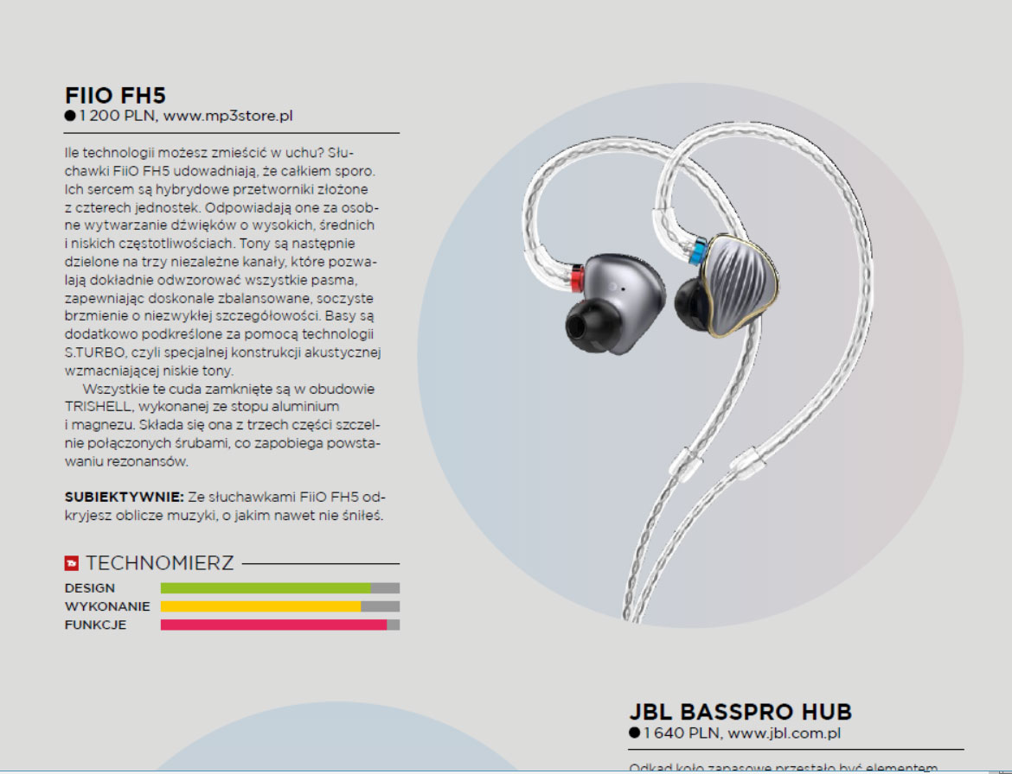
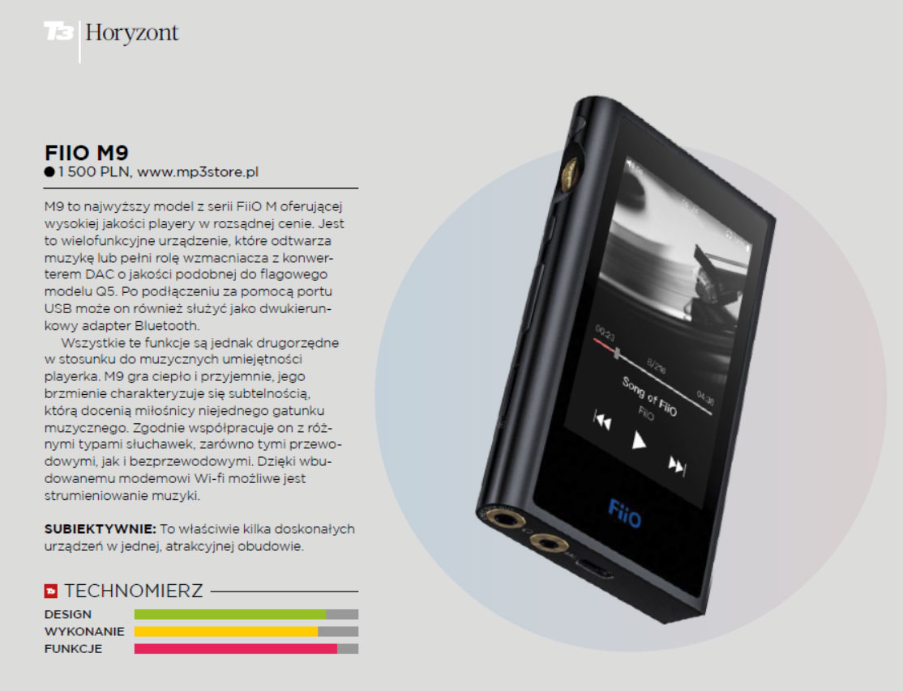
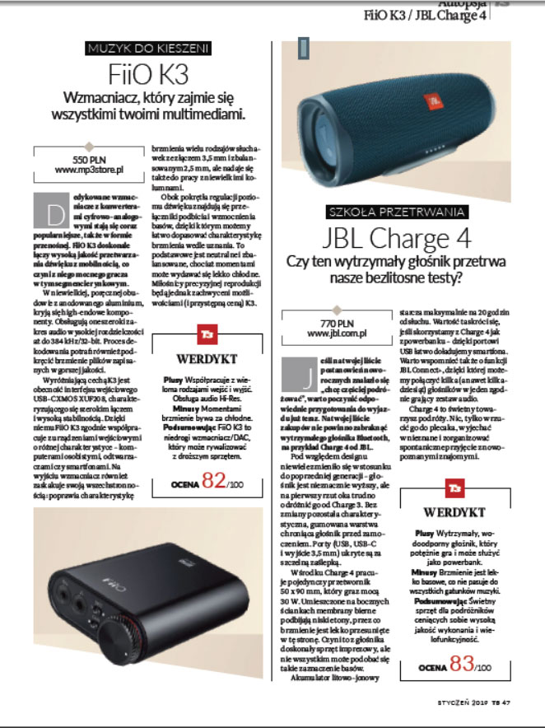
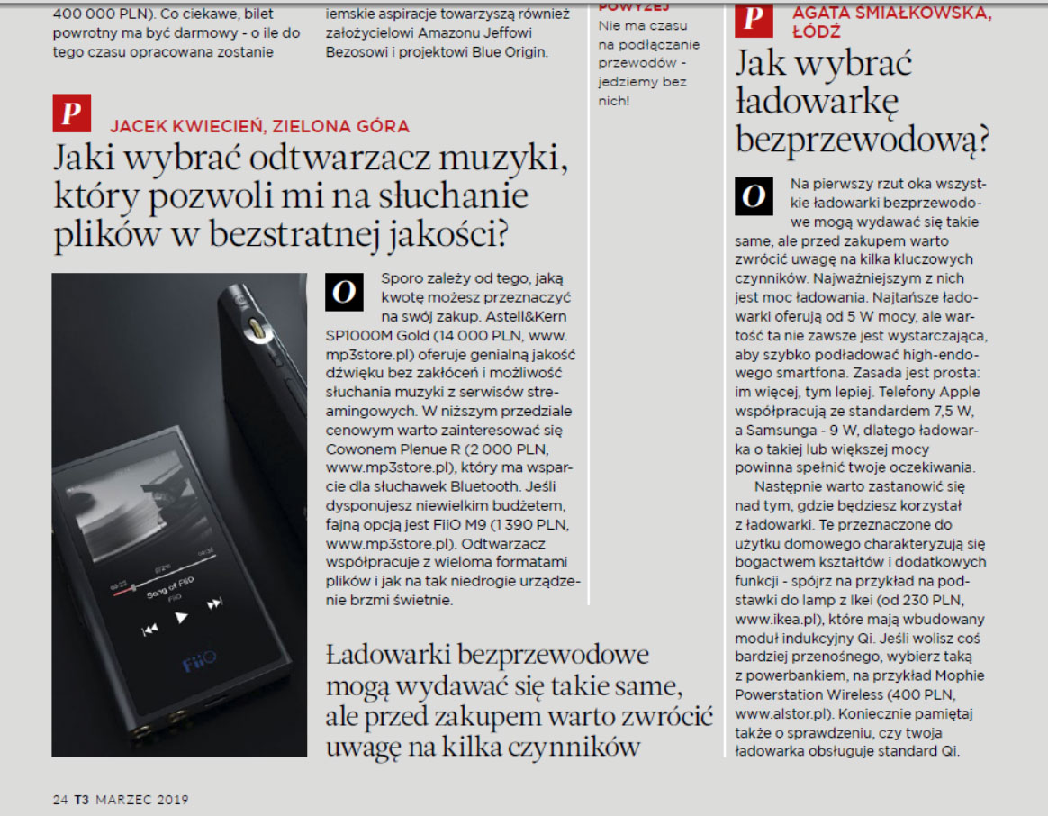
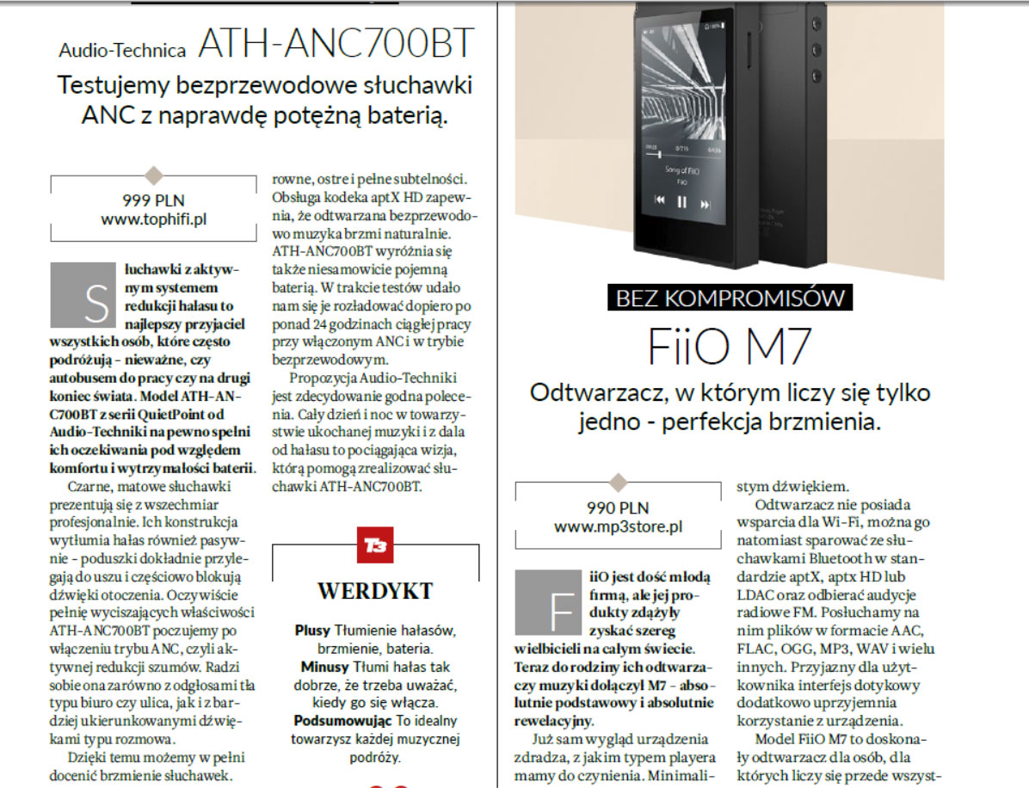
Some Adverts & Product Placement

Slide 8
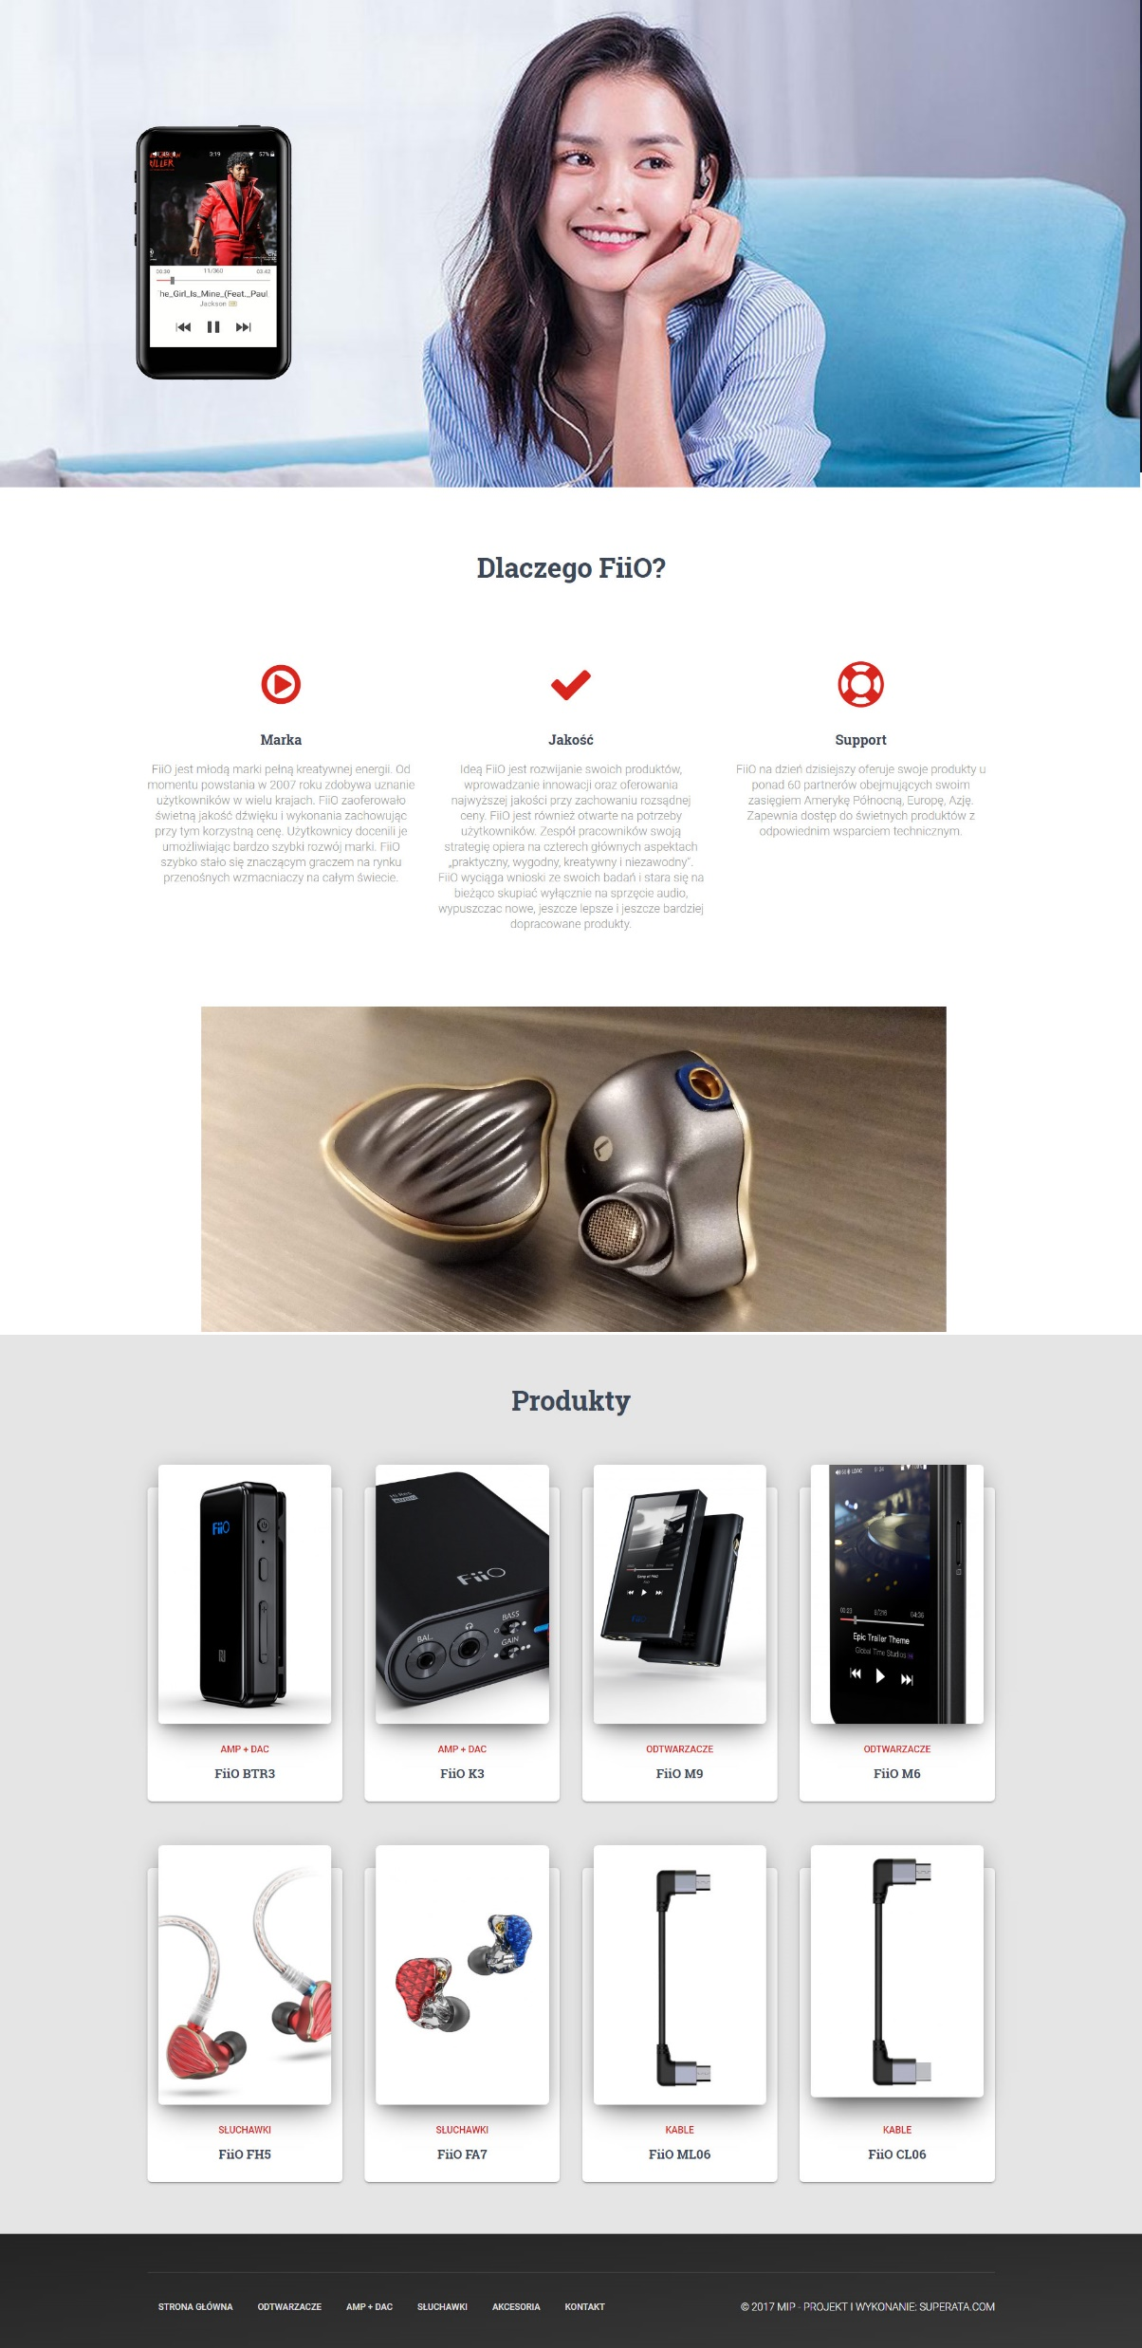
Polish Webside Update

Slide 9
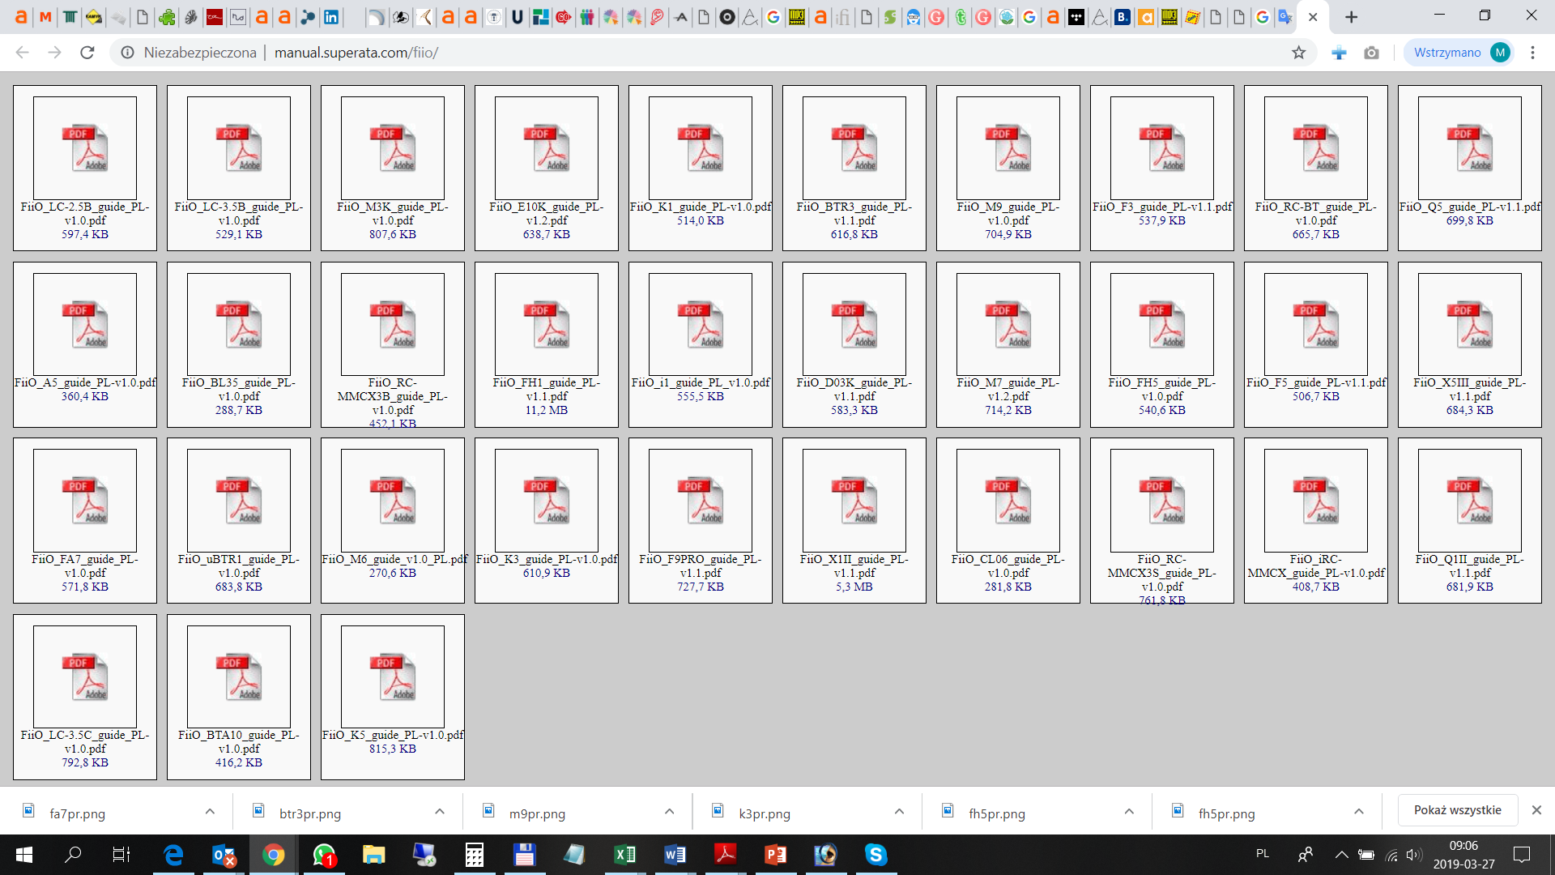
Ongoing process of products manual translation for new models and other fiio products still in sales
http://manual.superata.com/fiio/

Slide 10
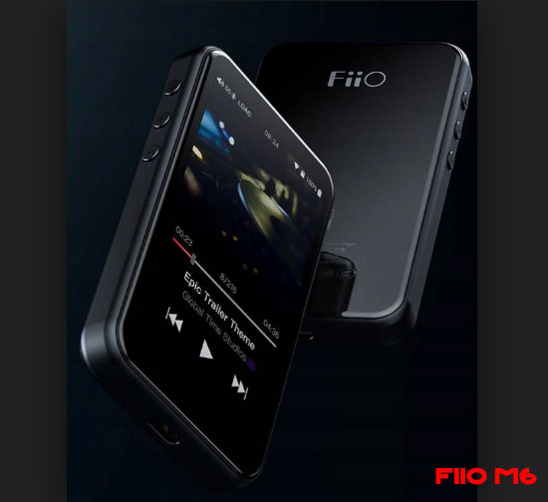
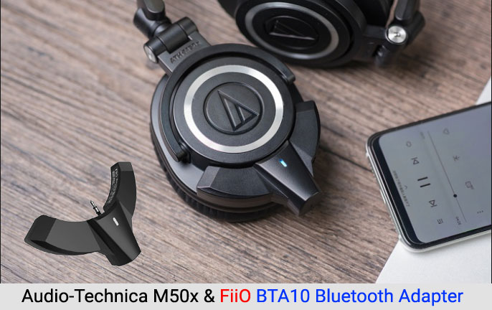
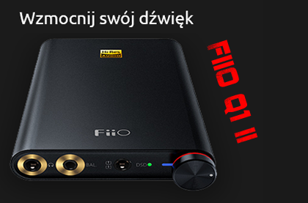
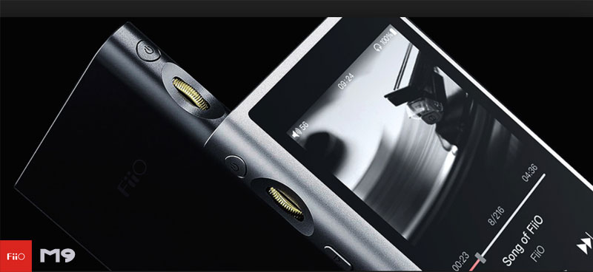
Banners for internet promotion

Slide 11
Example of Banners exposure

Slide 12
Exhibition - Audioshow

Slide 13
Audio Enthusiast Meeting together with local stores and discusion on audio community
Last Meet in Wroclaw in March 2019
https://forum.mp3store.pl/topic/139388-projekt-wroc%C5%82awska-mita-2016-czerwiec/
Last Meet in Poznan in Feruary 2019
https://forum.mp3store.pl/topic/157380-meet-mp3store-pozna%C5%84-23022019/

Slide 14
Brand Awareness in Big Retails
X-KOM – Several offline stores – it/electronics (earphones, soon amp/dacs)
Update: Now they put full offer for FiiO. Before only earphones
Euro RTV-AGD – big electronic retail,c. 150 offline stores in big cities (players, soon the rest of the offer)
Update: Now they put full offer for FiiO.
Empik – retail similar to Virgin - c. 150 offline stores (all models)
AB – Big IT distrbutor (all models)
MP3Store – 9 specialised audio stores (Full offer and expo)

Slide 15
Brand Awareness in Big Retails
Media Expert – big electrnics retail, c. 300 offline stores in middle and small cities (uploading now)
Update: Now they put full offer for FiiO.
Carrefour – big FMCG/Electronics retail (all models)
Morele.net- famous internet e-tailer with offline pick-up points
Emag.pl – another important e-tailer. Now bought by Romanian Company
Update: Now full offer.

Slide 16
New Customers – Good for FiiO Marketing and Sales
Electro.pl –almost full offer
Avans.pl – almost full offer
Oleole! – just earphones

Slide 17
Example of on store marketing

